Slide 1

AROUND THE PICNIC TABLE
Finance
2020
Update
Leslie Backus
Class A (nonalcoholic) Trustee
General Service Board Treasurer
Notes:
Slide 0 – Good afternoon. My name is Leslie Backus and I am a Class A trustee and treasurer of the General Service Board. It is my privilege to deliver the promised updated Treasurer's report. As promised during the 70th General Service Conference of Alcoholics Anonymous this report contains final numbers based on the audited financials of Alcoholics Anonymous. We need to continue to provide up to date financials and we need better communications about what finance really means when members talk about the “numbers” around the euphemistic picnic table. And now, during the pandemic, we need even more clear communications about the finances of GSO, AAWS and AA Grapevine.

Slide 2
2019 AUDIT RESULTS
First draft of the Audit was completed on May 31st
There was an issue with functional expenses that staff had to investigate – it was a NetSuite issue and it took about 4 weeks to resolve
The final Audit was completed and sent to the Audit Committee for review in early July.
Audit Committee met with Marks Paneth, LLC, the independent auditors on July 13th to review the audit and to discuss any issues they discovered
Notes:
The Audit Committee met with the independent auditor to review and accept the final audit on July 13th

Slide 3
2019 AUDIT RESULTS
The independent auditor reported that all three corporations’ financial statements received unmodified opinions
In addition, the auditors reported no material weaknesses
The auditors made 14 recommendations to improve our processes. Management has responded to all the recommendations

Slide 4
2019 AUDIT RESULTS
Why did the audit take so long?
The audit had to work in 2 accounting systems: Traverse and NetSuite since the transition to NetSuite started mid year
There were ongoing issues with the transition to NetSuite that delayed getting information to the auditors
Onsite audit fieldwork was ongoing when COVID-19 hit and the office had to close; although staff had been making arrangements to complete all the audit work offsite the order to shelter in place came sooner than expected and not everything was prepared

Slide 5
2019 FINANCIAL HIGHLIGHTS
7th Tradition of Self-Support – $8.86 million set another record, up 5.71% from 2018
AAWS publishing profits – $9,36 million down 1% from 2018, used to cover shortfall between 7th Tradition and Cost of Services, resulting in net GSO loss of $380,450 ($379,665 was reported in May)
Grapevine subscription levels decreased 2% in 2019. 2019 results were a loss of $27,303 ($44,461 was reported in May)
General Fund support of La Viña service activity – $297,392 ($289,314 was reported in May)
Reserve Fund – $16.2 million resulting in ratio of 9.2 months

Slide 6
2019 FINANCIAL HIGHLIGHTS
Due to many issues with the transition to the new ERP system the audit on the financial results for 2019 has not been completed. The audit should be completed and reviewed by the Audit Committee by May 30th.
The first draft of the audit was completed on May 31st and after careful review a few corrections were made and the audit was accepted by Audit Committee July 13th.
So if you see a few numbers that don’t quite match don’t worry the Finance Department and Marks Paneth, our independent auditors, are working to make sure the final audited financial for 2019 are correct.
Now all the figures are correct – so the financials you will receive today are based on the audited results.

Slide 7
2020 Budgets – Where Are They?
Budgets for 2020 are also being reviewed and updated
AAWS has completed the 2020 amended budget, titled Budget Reforecast 2.01
Budget Reforecast 2.01 includes adjustments due to COVID-19 and reflects both a decrease in anticipated revenue as well as a decrease in anticipated expenses
AA Grapevine will revise the 2020 budget by the October Board weekend

Slide 8
2019 FINANCIAL HIGHLIGHTS
Amounts in $ | 2019 ACTUAL | 2019 BUDGET | COMPARED TO 2019 BUDGET | 2018 ACTUAL | COMPARED TO 2018 ACTUAL
GENERAL SERVICE OFFICE
7th Tradition Contributions | 8.86 M | 8.38 M | 0.48 M (5.7%) increase | 8.38 M | 0.48 M (5.7%) increase
Cost of Services Provided to Fellowship | 11.6 M | 11.2 M | 0.4 M (4%) increase | 11.4 M | 0.2M (2%) increase
Shortfall between 7th Tradition & Cost of Services | 2.7 M | 2.8 M | 0.1 M (4%) decrease | 3 M | .3 M (10%) decrease
Net Income | (0.38)M | 0.5 M | (0.8 M) ( 176%) decrease | 0.4 M | 1.4 M (196%) decrease
GRAPEVINE & LA VINA
Average Circulation | 71,182 | 76,086 | 4,904 (6.5%) decrease | 72,300 | 1,118 (1.5%) decrease
Net Income (Loss) | (27,303) | (135 K) | 107.7K (79.8%) better | -149 K | 275 K (82%) increase
General Fund support of La Viña service activity | 297 K | 166 K | 131K increase | 148 K | 149 K (101%) increase
RESERVE FUND
Coverage Ratio | 9.2 months | 9.4 months | Decrease of 0.4 months (7%) | 9.7 months | Increase of 0.5 months
M – millions; K – thousands

Slide 9


GRATITUDE
7TH TRADITION

Slide 10
7TH TRADITION – 2019 – $8.86 MILLION
28,180 GROUPS - $6,930,608
INDIVIDUALS -$1,235,764
TOTAL 7TH TRADITION $8,863,480
RECORD 7TH TRADITON

Slide 11
2019 HIGHLIGHTS
28,180 Groups made $6.9 million of 7th Tradition contributions
  Represents 40.6% of total groups
  $245.715 average group contribution
Individuals, Memoriam & Special Meetings contributed
$1.3 million of 7th Tradition contributions
Total 7th Tradition contributions were $8.86 million

Slide 12
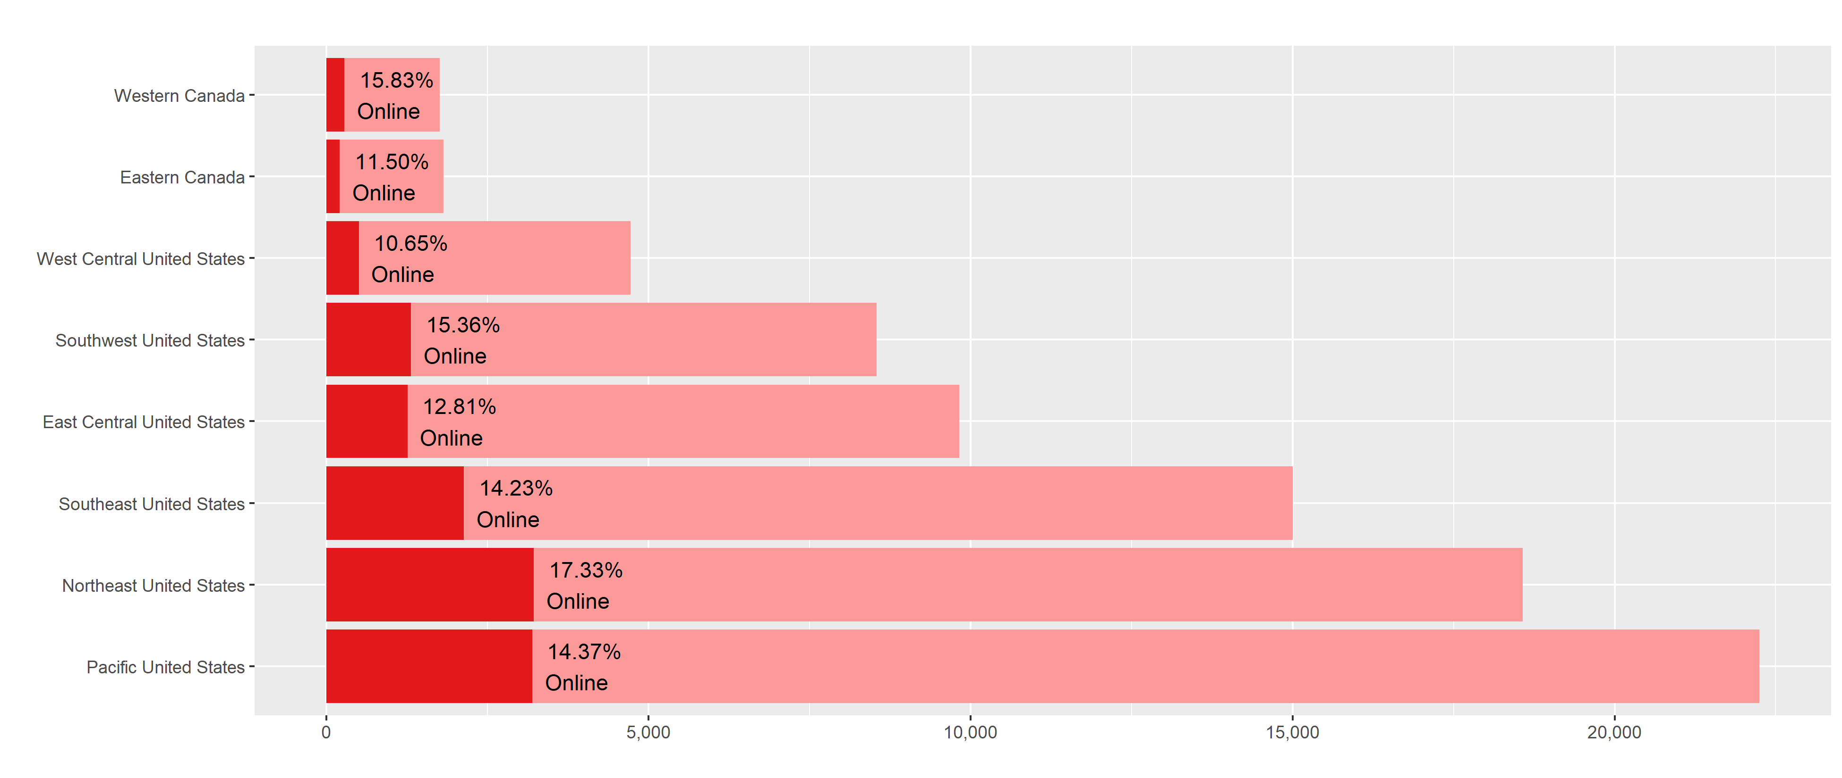
7th Tradition Contributions
Number Received by Region
Notes:
These two horizontal column plots are simple totals, grouped by region. I added the online highlight to add a bit more insight onto the visual as this may be interesting to revisit next year/as our online presence improves with the webstore/contributions online projects.

Slide 13
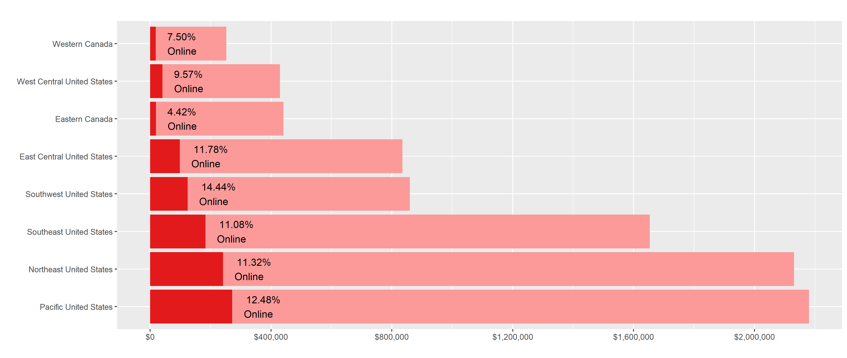
7th Tradition Contributions
Regional Impact by Value (USD)
Notes:
The ascending arrangement changes as a result of the total dollar value behind each region’s contributions.

Slide 14
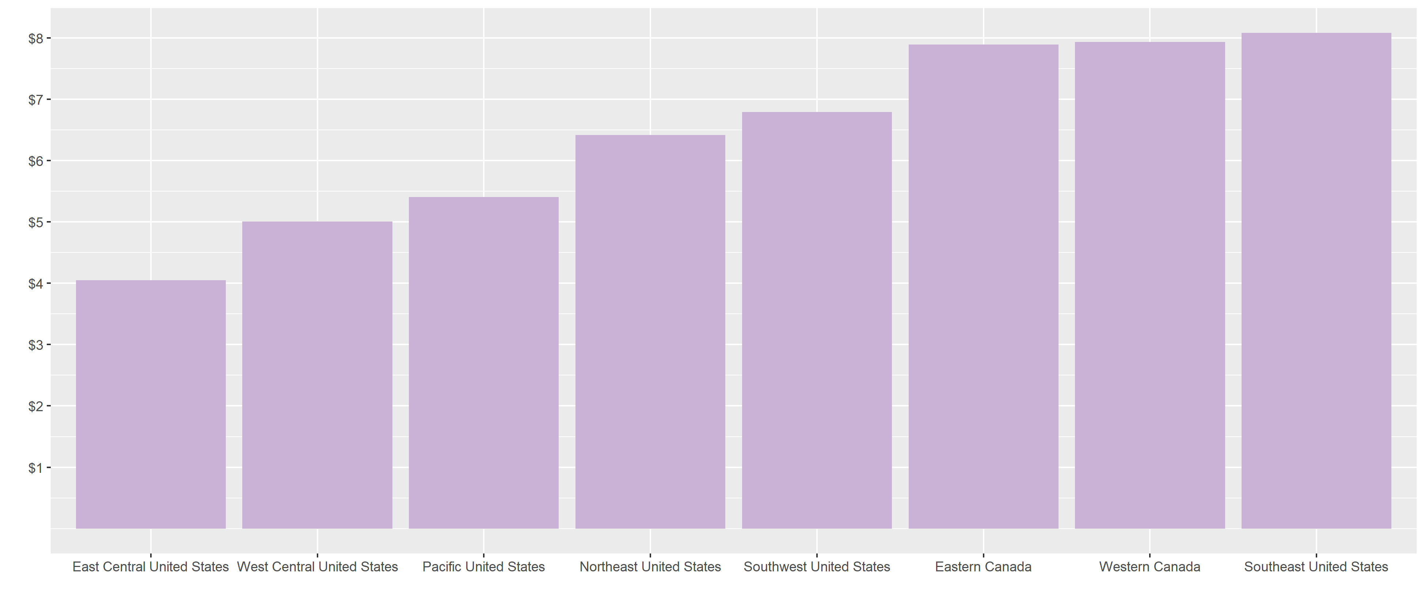
7th Tradition Contributions
Regional Per Capita
Notes:
t.

Slide 15
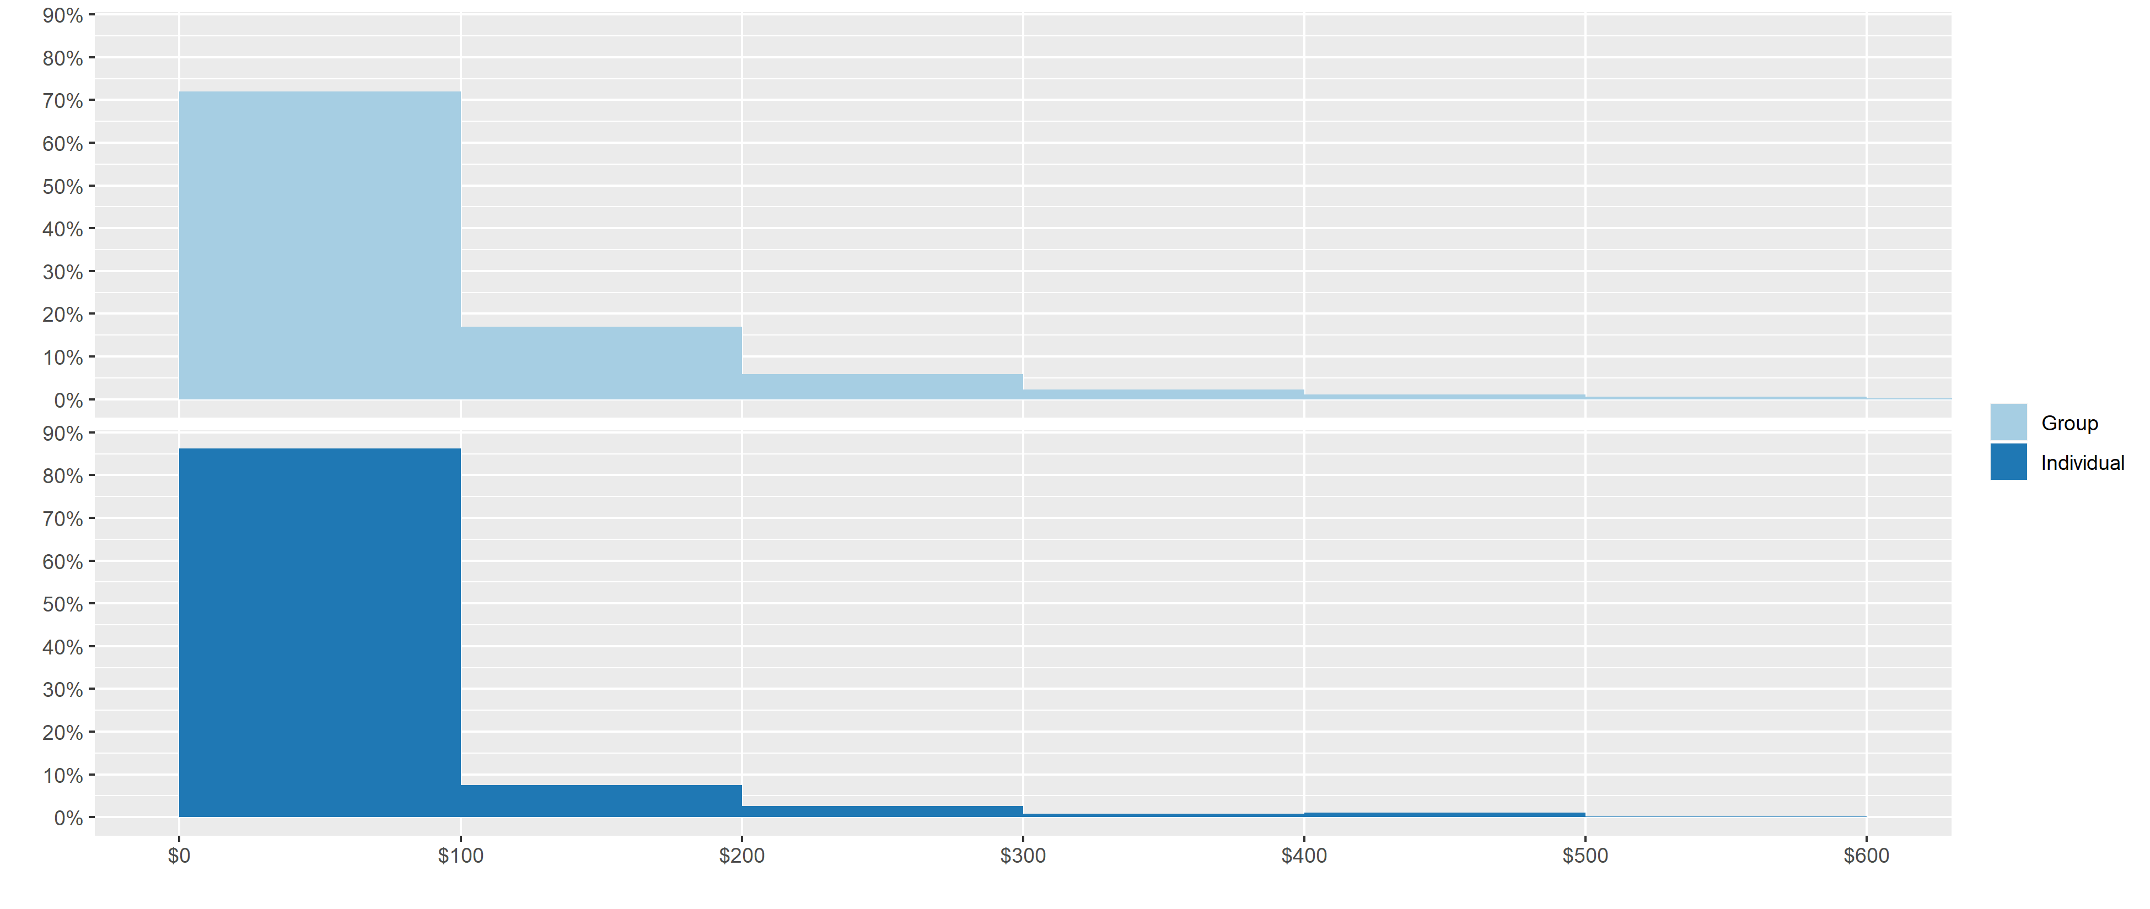
Distribution of Received Contributions
Notes:
This graph illustrates the distribution by the amount of the contributions. Just over 70% of group donations are $100 or less while 86% of individual contributions are under $100.

Slide 16
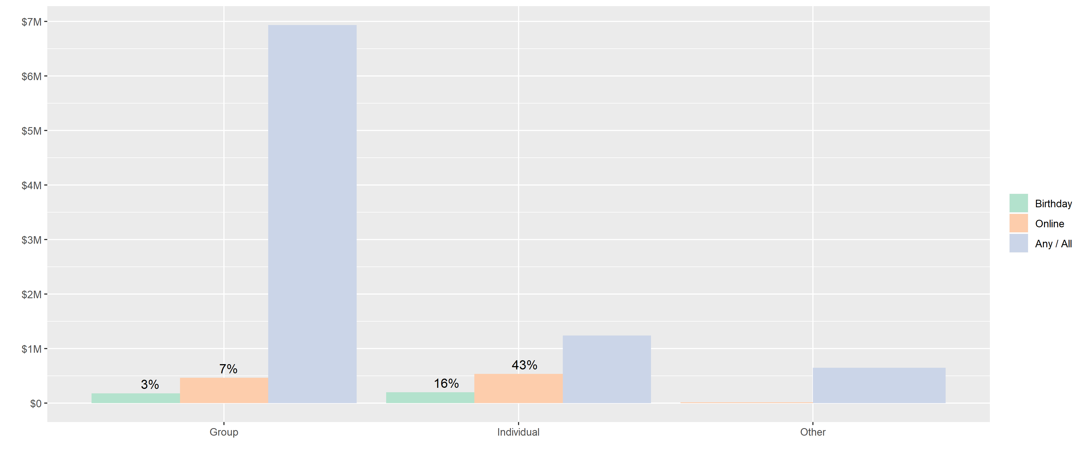
7th Tradition Contributions
Impact by Value (USD)

Slide 17
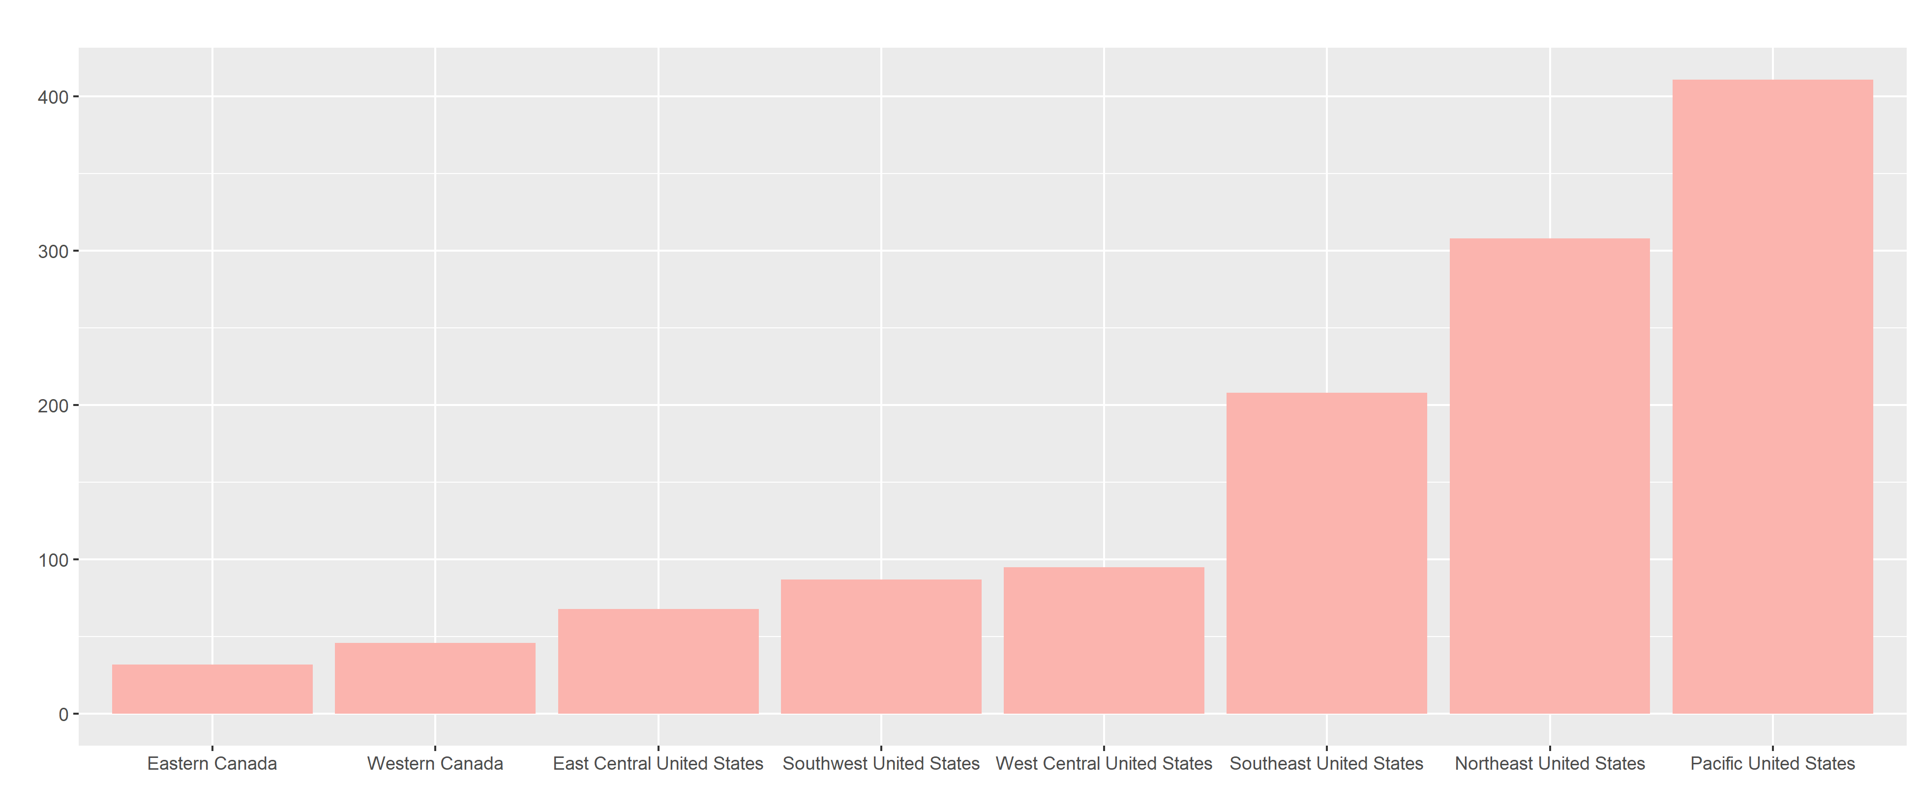
“$8.06” Contributions
Number Received by Region

Slide 18
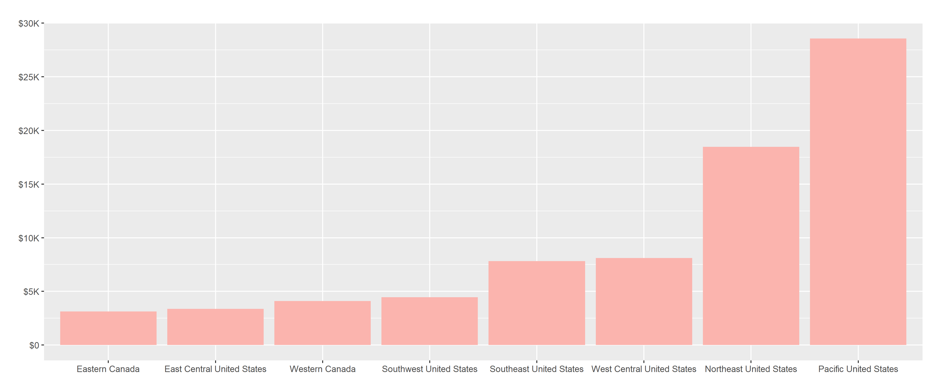
“$8.06” Contributions
Regional Impact by Value (USD)
2019 Total
$78,029.99

Slide 19
GROWTH OF ON-LINE CONTRIBUTIONS
2010 – 2019

Slide 20
7TH TRADITION SELF-SUPPORT – 2005 – 2019

Slide 21


A DOLLAR IS NOT WHAT IT USED TO BE
Remember inflation when deciding upon your
7th Tradition
Self-Support
Contributions for:
Group Meetings
Online Recurring Contributions
Birthday Gifts
November Gratitude Month
1935: $1.00
2019: $18.84
Notes:
Slide 20 – illustrates the pervasive and very negative effects of how inflation has diminished the value or purchasing power of one dollar since the very first days of A.A. through today. It shows that $1.00 in June 1935 is now equivalent to $18.55 in 2019, regardless of what that 1935 dollar was spent on, whether it went for alcohol, coffee or put into the 7th Tradition Self-Support basket.
Source – 2019 inflation information is from U.S. Department of Labor, Bureau of Labor Statistics, CPI Inflation Calculator website.

Slide 22

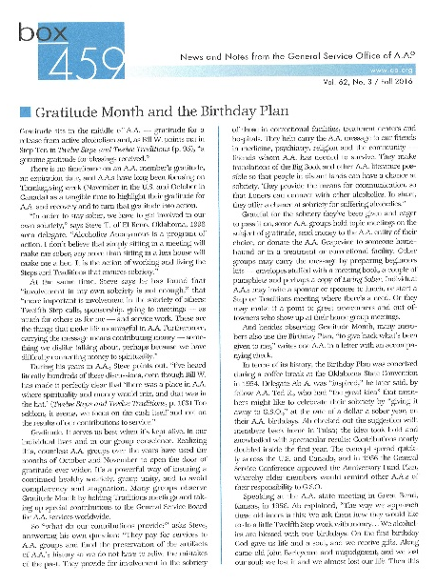


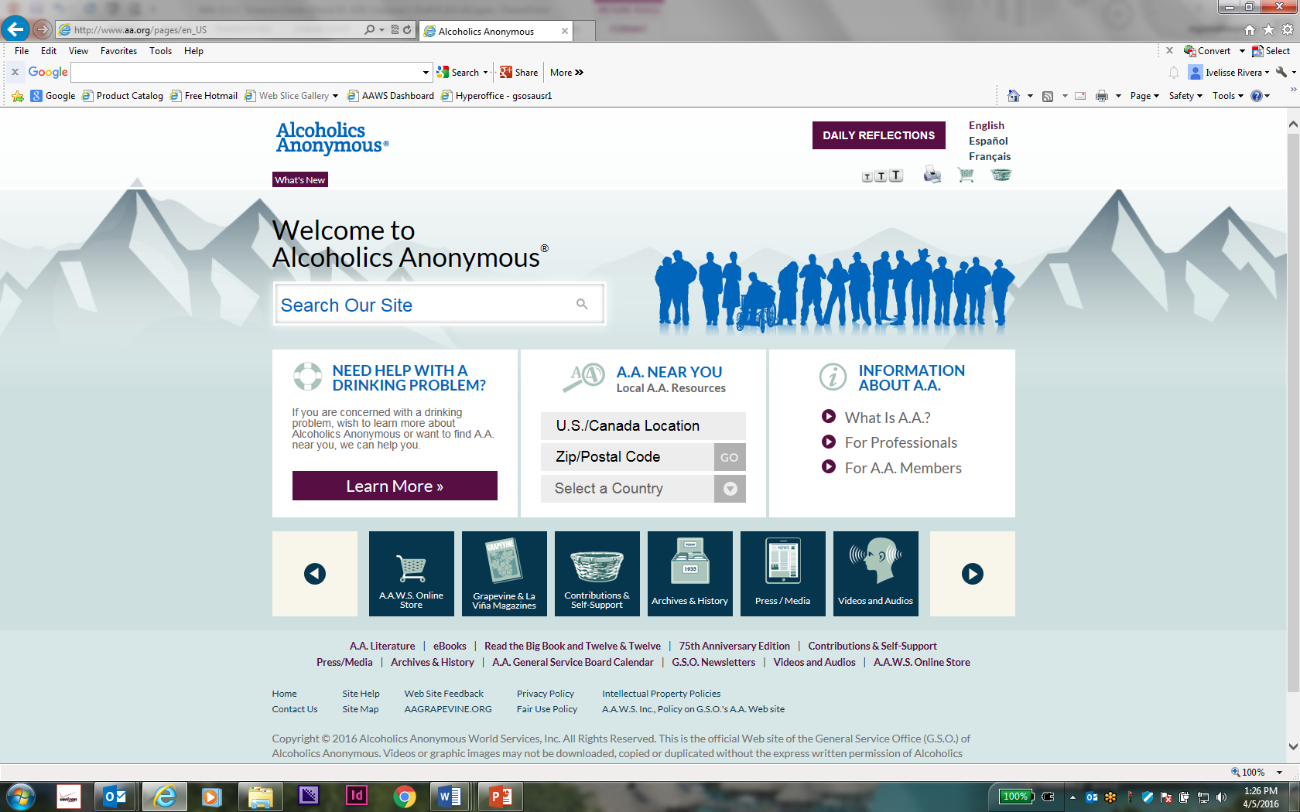

G.S.O.’s TWO BASIC FUNCTIONS
Publishing
Services on Behalf of the G.S.B.
Group Records

Slide 23
AAWS – PUBLISHING – 2019 ACTUAL VS 2019 BUDGET
$ in Thousands | 2019 ACTUAL | 2019 BUDGET | INCREASE (DECREASE)
Net Sales – Literature | 14,259 | 14,775 | (516)
Cost of Literature Sold | 2,646 | 3,100 | (454)
Direct Shipping and Warehousing | 1,956 | 1,900 | 56
Gross Profit | 9,657 | 9,775 | (118)
Gross Profit Percentage | 67.7% | 66.2% | 1.5%
The YTD sales to budget variance was largely due to lower than anticipated sales of “Our Great Responsibilities” | 34,137 | 100,000 | (65,863) 66% decrease
Notes:
3,249,000.

Slide 24
GSO & AAWS – OPERATING RESULTS – 2005 – 2019
2005 2006 2007 2008 2009 2010 2011 2012 2013 2014 2015 2016 2017 2018 2019

Slide 25
GRAPEVINE – 2019 ACTUAL VS 2019 BUDGET
 |  |  | 2019 Actual | 2019 Budget | Increase (Decrease)
Average Circulation-Print |  |  | 66,376 | 69,139 | (2,763)
Online & App |  |  | 4,806 | 6,947 | (2,141)
Revenue |  |  | 1,978 | 2,086 | (108)
Expenses |  |  | 2,005 | 2,220 | 215
Net Income |  |  | (27) | (134) | 107
$ in Thousands

Slide 26
GRAPEVINE – KEY AMOUNTS – 5 YEAR HISTORY

Slide 27
GRAPEVINE OPERATING RESULTS – 2005 – 2019

Slide 28
GRAPEVINE – AVERAGE CIRCULATION – 5 YEAR HISTORY

Slide 29
LA VINA – 2019 ACTUAL
 |  |  | 2019 Actual
Average Circulation-Print |  |  | 10,150
Revenue |  |  | 65,095
Expenses |  |  | 362,487
Net Income |  |  | (297,392)
$ in Thousands

Slide 30
La Viña – AVERAGE Circulation – 2005 – 2019

Slide 31
G.S.O.’s TWO BASIC FUNCTIONS
Publishing
Services on Behalf of the G.S.B.
Group Records
Notes:
Remember this slide? So now we are going move to the service side.

Slide 32
FELLOWSHIP SERVICES – DIRECT COSTS & PERCENTAGES
$ in Thousands | 2019 | % of Total | 2018 | % of Total | 2017 | % of Total
Public Information | 327 | 2.9 | 336 | 2.9 | 368 | 3.6
Cooperation with Professional Community | 292 | 2.6 | 297 | 2.6 | 283 | 2.8
Treatment Facilities | 132 | 1.2 | 131 | 1.1 | 141 | 1.4
Corrections | 294 | 2.6 | 329 | 2.9 | 298 | 2.9
Overseas Services (Literature Assistance) & Loners | 526 | 4.6 | 501 | 4.4 | 563 | 5.5
Regional Forums | 532 | 4.7 | 453 | 4.0 | 465 | 4.5
Archives | 800 | 7.0 | 791 | 6.9 | 780 | 7.6
Spanish Services | 27 | 0.1 | 0 | 0 | 0 | 0
Communications | 189 | 1.6 | 0 | 0 | 0 | 0
Sub-Total – Outreach | 3,109 | 25.4 | 2,838 | 24.8 | 2,898 | 28.3
General Service Conference | 1,114 | 9.5 | 1,092 | 9.6 | 770 | 7.5
Trustees & Directors Activities | 577 | 4.9 | 601 | 5.2 | 492 | 4.8
Nominating | 259 | 2.2 | 269 | 2.3 | 269 | 2.6
International Convention | 190 | 1.6 | - | - | - | -
World Service Meeting | 203 | 1.8 | 203 | 1.8 | (5) | -
Sub –Total – Service Leadership | 2,164 | 18.3 | 2,165 | 18.9 | 1,526 | 14.9
Group Services | 2,202 | 18.7 | 2,235 | 19.6 | 2,275 | 22.3
Supporting Services (Technology, Finance, etc.) | 4,329 | 37.9 | 4,189 | 36.7 | 3,523 | 34.5
Total Costs of Services Provided | 11,804 | 100.0 | 11,427 | 100.0 | 10,222 | 100.0
$ increase over prior year – % increase over prior year | 377 | 3.3 | 1,205 | 11.8% | 315 | 3.2%
La Viña Service Activity - NOTE – GSB support for the La Viña service activity is NOT an actual operating expense of GSO, but is included here to show its relative significance of this service. | 297 | n/a | 148 | n/a | 126 | n/a
Notes:
Slide 27 – Support 1 – breaks down 2019 total costs of services provided to the Fellowship of $11,804 into its functional service activities. 2019 cost of services provided increase of $377,000, or 3.3% from 2018. There are 2 new outreach services that I would like to highlight – Spanish Services and Communications. This functional service breakdown is similar to the way the information has been presented in previous years and is a more understandable way of explaining what the costs of services provided to the Fellowship are. The amounts shown above are the direct costs, principally people costs, of each of the major service activities performed by GSO.
This slide includes the General Service Board support for the La Viña service activity. The key is that the $297,392 is NOT an actual operating expense of GSO, but it is included to show its relative significance of this service activity compared to the others. This has been an expressed desire of many and the Second Subcommittee on Financial Reporting of La Viña concluded in 2018 that this approach is appropriate for our unaudited reporting.

Slide 33
RECURRING OPERATING EXPENSES – 2019 – $18.6 M
FINANCIAL STATEMENT EXPENSE CATEGORIES
PERCENTAGE BREAKDOWN
Notes:
Slide 17 – shows the percentage of each of the expense categories of 2019 total recurring operating expenses of $18,602,773. This expense is used in the Reserve Fund Ratio (Slide 60). Expenses related to people costs are 63.0% (20178– 63.6%) and 54.8% for occupancy. We pay $23.23 per square foot for our 35,370 square feet of space and that includes janitorial services. Slide 57 – Support 12 contains a detailed breakdown of Retirement Expense (10.1%). Slide 26 contains a detailed breakdown of Travel, Meals and Accommodations (7.0%). Slide 27 contains a detailed breakdown of Contracted Services (10.8%). Slide 28 contains a detailed breakdown of Professional Fees (3.6%). Selling Expenses are primarily credit card processing (interchange) fees, along with the related credit card license and compliance testing arising from our sale of literature (2.4%). See Slide 24 – Support 1 for details.

Slide 34
Notes:
Slide 30 – Support 2 – is the slide from the 68th GSC Finance Presentation repeating the 2017 information for reference purposes. The chart breaks down the total cost of services provided to the Fellowship of $10,222,650 into four buckets. The amounts shown above are the direct costs, principally people costs, of each of the major service activities performed by GSO.
Slide 31 – Support 1 – Outreach service activities, consisting of – Public Information; Cooperation with Professional Community; Treatment Facilities; Correctional Facilities; Overseas Services & Loners; Regional Forums; and Archives – $2,897,401.
Slide 32 – Governance, consisting of – General Service Conference; Trustee Director Activities; Nominating Activities; and Other (primarily the World Service Meeting) – $1,526,000.
Slide 33 – Support 1 – Group Services – $2,274,676.
Supporting Services – $3,523,000 includes the direct costs of administration, finance, human resources, information technology, and all other indirect overhead. It would not be possible for the service activities listed above to operate without these supporting services.

Slide 35
OUTREACH SERVICES PROVIDED TO FELLOWSHIP 2019 – $3.1 M
Notes:
Slide 23 – breaks down 20189total costs of outreach services of $2,837,550, consisting of Public Information; Cooperation with Professional Community; Treatment Facilities; Corrections; Overseas Services and Loners; Regional Forums; and Archives. This functional service breakdown is consistent with the way the information has been presented in prior years. The amounts shown above are the direct costs, principally people costs, of each of the major service activities performed by GSO. The 2019 costs are similar to those of prior years. This slide includes the General Service Board support for the La Viña service activity. The key is that the $297,392 is NOT an actual operating expense of GSO, but it is included here to show its relative significance of this service activity compared to the others. This has been an expressed desire of many and the Second Subcommittee on Financial Reporting of La Viña concluded in 2018 that this approach is appropriate for our unaudited reporting.

Slide 36
OUTREACH SERVICES PROVIDED TO FELLOWSHIP – 3 Year History
NOTE – GSB support for the La Vina service activity is NOT an actual operating expense of GSO, but is included here to show its relative significance of this service activity.
Notes:
Slide 31 – Support 1 – breaks down 2019 total costs of outreach services of $3,109, consisting of Public Information; Cooperation with Professional Community; Treatment Facilities; Corrections; Overseas Services and Loners; Regional Forums; and Archives. This functional service breakdown is consistent with the way the information has been presented in prior years. The amounts shown above are the direct costs, principally people costs, of each of the major service activities performed by GSO. The 2019 costs are similar to those of prior years.
This slide includes the General Service Board support for the La Viña service activity. The key is that the $297,392 is NOT an actual operating expense of GSO, but it is included here to show its relative significance of this service activity compared to the others. This has been an expressed desire of many and the Second Subcommittee on Financial Reporting of La Viña concluded in 2018 that this approach is appropriate for our unaudited reporting.

Slide 37
SERVICE LEADERSHIP ACTIVITIES
4 YEAR HISTORY
Notes:
Slide 32 – breaks down the 2019 costs of service leadership activities of $2,164,000 between the General Service Conference (GSC) – $1,114,398; Trustee Director Activities – $576,856; Nominating Activities – $259,042; and World Service Meeting – $24,170. Except for the WSM, 2019 costs were essentially even with prior years. Note the total include International Convention but that is not represented on the graph since it only occurs every 5 years

Slide 38
SERVICES SUPPORTED BY 7TH TRADITION
DOLLARS AND PERCENTAGE
Notes:
Slide 31 – shows the 2019 shortfall of $2,941,0006 between 7th Tradition of self-support received of $8,863,480 (Slide 7) and the cost of services provided to the Fellowship of $11,804,000. Approximately 75.1% of the cost of services provided to the Fellowship was covered in 2019, compared to 73.4% in 20108, 82.3% in 2017 and 80.1% in 2016. Although more costs were covered by 7th Tradition Contributions this year the continuing increases in the cost of services is a worry. But in 2020 budgets have been cut so this may look different next year, there are savings in travel, salaries and other items due to the pandemic that will result in a savings.

Slide 39
SERVICES SUPPORTED BY 7th TRADITION
DOLLARS AND PERCENTAGE – 2004 – 2019
Notes:
Slide 36 – Support 1 – shows the dollars and the percentage of the cost of services provided to the Fellowship that were covered through the 7th Tradition for the last fifteen years. For 2018, the percentage was 73.4%.

Slide 40
Questions Received Since Conference
Budgets – Where are they???

Slide 41
 | 2020 AAWS/GSO Budget Reforecast 2.01 | Year End 2019 | Original 2020 Budget | YTD Actual (June) | July | August | September | October | November | December | Total Balance of Year | Full Year
Revenue:
 | Gross Literature Sales | 14,405,491 | 14,750,000 | 4,918,121 | 500,000 | 600,000 | 700,000 | 800,000 | 900,000 | 1,000,000 | 4,500,000 | 9,418,121
 | Discounts | 190,311 | 200,000 | 49,694 | 7,550 | 9,060 | 10,570 | 12,080 | 13,590 | 15,100 | 67,950 | 117,644
 | Net Sales | 14,215,180 | 14,550,000 | 4,868,427 | 492,450 | 590,940 | 689,430 | 787,920 | 886,410 | 984,900 | 4,432,050 | 9,300,477
Cost of Goods Sold:
 | Manufacturing | 2,883,755 | 2,750,000 | 1,215,721 | 98,490 | 118,188 | 137,886 | 157,584 | 177,282 | 196,980 | 886,410 | 2,102,131
 | Warehouse & Shipping | 1,972,672 | 2,000,000 | 634,817 | 69,329 | 83,117 | 96,906 | 110,694 | 124,483 | 138,272 | 622,801 | 1,257,617
Total Cost of Goods Sold |  | 4,856,427 | 4,750,000 | 1,850,537 | 167,819 | 201,305 | 234,792 | 268,278 | 301,765 | 335,252 | 1,509,211 | 3,359,748
 | Gross Profit From Literature Sales | 9,358,753 | 9,800,000 | 3,017,890 | 324,631 | 389,635 | 454,638 | 519,642 | 584,645 | 649,648 | 2,922,839 | 5,940,729
Contributions:
 | Individual/Groups | 8,863,480 | 9,000,000 | 4,086,924 | 883,579 | 900,000 | 900,000 | 900,000 | 900,000 | 900,000 | 5,383,579 | 9,470,503
 | Area Delegate Fees | - | - | 147,600 | 19,800 | - | - | - | - | - | 19,800 | 167,400
 | Additional Area Contributions | - | - | 103,346 | - | - | - | - | - | - | - | 103,346
 | World Service Meeting & ILF | - | - | 20,468 | - | - | - | - | - | - | - | 20,468
Total Contributions |  | 8,863,480 | 9,000,000 | 4,358,338 | 903,379 | 900,000 | 900,000 | 900,000 | 900,000 | 900,000 | 5,403,379 | 9,761,717
Total Revenue |  | 18,222,233 | 18,800,000 | 7,376,228 | 1,228,010 | 1,289,635 | 1,354,638 | 1,419,642 | 1,484,645 | 1,549,648 | 8,326,218 | 15,702,447

Slide 42
Expenses:
Payroll & Benefits
 | Salaries | 7,863,018 | 8,547,225 | 3,917,965 | 925,000 | 620,000 | 586,000 | 541,000 | 541,000 | 811,500 | 4,024,500 | 7,942,465
 | Severance | - | - | - | - | - | 500,000 | 500,000 | - | - | 1,000,000 | 1,000,000
 | Payroll Taxes | 561,783 | 640,000 | 329,461 | 69,375 | 46,500 | 43,950 | 40,575 | 40,575 | 60,863 | 301,838 | 631,299
 | Insurance | 1,361,858 | 1,450,000 | 703,230 | 117,000 | 22,805 | 110,000 | 110,000 | 110,000 | 110,000 | 579,805 | 1,283,035
 | Retirement | 1,852,271 | 1,875,000 | 178,728 | 30,000 | 30,000 | 30,000 | 30,000 | 30,000 | 30,000 | 180,000 | 358,728
Subtotal Payroll & Benefits |  | 11,638,930 | 12,512,225 | 5,129,384 | 1,141,375 | 719,305 | 1,269,950 | 1,221,575 | 721,575 | 1,012,363 | 6,086,143 | 11,215,526
Other Expenses
 | Other program printing | 362,482 | 355,000 | 49,763 | 41,041 | 100,000 | - | - | - | - | 141,041 | 190,804
 | Mailing, labor etc. | 118,261 | 140,000 | 28,074 | 4,700 | 4,700 | 4,700 | 4,700 | 4,700 | 4,700 | 28,200 | 56,274
 | Postage & express | 276,287 | 350,000 | 34,084 | 5,700 | 5,700 | 5,700 | 5,700 | 5,700 | 5,700 | 34,200 | 68,284
 | Editorial services | 95,316 | 95,000 | 18,082 | 3,013 | 3,013 | 3,013 | 3,013 | 3,013 | 3,013 | 18,078 | 36,160
 | Other literature assist | 3,585 | 10,000 | 1,485 | - | - | - | - | - | - | - | 1,485
 | Selling expenses | 161,330 | 221,330 | 151,722 | 16,573 | 13,000 | 13,000 | 13,000 | 13,000 | 13,000 | 81,573 | 233,295
 | Professional fees | 677,653 | 360,000 | 232,110 | 25,000 | 25,000 | 25,000 | 25,000 | 25,000 | 25,000 | 150,000 | 382,110
 | Contracted services | 2,031,948 | 1,673,805 | 961,098 | 202,425 | 113,110 | 142,386 | 109,498 | 110,110 | 107,204 | 784,733 | 1,745,831
 | Occupancy | 895,933 | 1,046,500 | 480,525 | 83,705 | 80,200 | 80,200 | 80,200 | 80,200 | 80,200 | 484,705 | 965,230
 | Telephone | 136,883 | 145,000 | 79,123 | 13,000 | 13,000 | 13,000 | 13,000 | 13,000 | 13,000 | 78,000 | 157,123
 | Furniture & equip maint. | 56,128 | 56,000 | 15,198 | 2,600 | 2,600 | 2,600 | 2,600 | 2,600 | 2,600 | 15,600 | 30,798
 | Furniture & equipment | 124,369 | 130,000 | 17,663 | 3,500 | 3,500 | 3,500 | 3,500 | 3,500 | 3,500 | 21,000 | 38,663
 | Stationery & office expense | 187,258 | 180,000 | 42,293 | 7,000 | 7,000 | 15,000 | 15,000 | 10,000 | 7,000 | 61,000 | 103,293
 | Office service & expense | 497,150 | 420,000 | 222,511 | 37,000 | 37,000 | 37,000 | 37,000 | 37,000 | 37,000 | 222,000 | 444,511
 | Travel, meals, & accommodations | 1,329,403 | 1,100,000 | 179,674 | 4,500 | 2,000 | 2,000 | 2,000 | 2,000 | 2,000 | 14,500 | 194,174
 | Bad debts | 8,972 | 4,000 | 2,392 | 300 | 300 | 300 | 300 | 300 | 300 | 1,800 | 4,192
Total Other Expenses |  | 6,962,958 | 6,286,635 | 2,515,796 | 450,057 | 410,123 | 347,399 | 314,511 | 310,123 | 304,217 | 2,136,430 | 4,652,226
 |  |  |  |  |  |  |  |  |  |  |  | -
Total Expenses |  | 18,601,888 | 18,798,860 | 7,645,180 | 1,591,432 | 1,129,428 | 1,617,349 | 1,536,086 | 1,031,698 | 1,316,580 | 8,222,573 | 15,867,752
 |  |  |  |  |  |  |  |  |  |  |  | -
Net Income (Loss) |  | (379,655) | 1,140 | (268,952) | (363,422) | 160,207 | (262,711) | (116,444) | 452,947 | 233,069 | 103,646 | (165,306)

Slide 43
Budget Reforecast 2.01
The original 2020 budget included expenses of $18,798,860
Reforecast 2.01 includes expenses of $15,867,752
A decrease of $ 2,931,108
The original 2020 budget included revenue of $18,800,000
Reforecast 2.01 includes revenue of $15,702,447
A decrease of $ 3,097,553
The original 2020 budget included Net Income of $ 1,140
Reforecast 2.01 includes a Net Loss of $ 165,306

Slide 44
Budget Reforecast 2.01 - Savings
Category | Savings
Travel, Meals & accommodations | $905,826
Salaries & Taxes | $771,726
Other Program Printing | $164,196
Mailing, labor, etc | $ 83,726
Postage & Express | $281,716
Occupancy | $ 81,270
Editorial Services | $ 58,840
Furniture & Equipment Maintenance (Copiers, etc.) | $ 25,202
Furniture & Equipment | $ 91,337
Office Expense | $ 76,707
Just these reductions save a total of | $2,540,547

Slide 45
Questions Received Since Conference
What’s up with the ERP system? NetSuite is the Enterprise Resource Planning (ERP) system that is being implemented at this time.
ERP refers to a type of software that organizations use to manage day-to-day business activities such as accounting, procurement, project management, risk management and compliance, and supply chain operations.
We are now on the right track in the finance module. A new chart of accounts has been uploaded, financials are being printed – right out of the software
Other departments are working in other modules in the ERP – soon the modules will work together and it will be worth all the hard work.
Notes:
Financials being printed directly from the software is a big deal for the accounting department. Over the years many excel spreadsheets have been created to provide reports and track expenses. So much of the work was done manually. Now with the new software, the correct chart of accounts and a lot of trial and error we are on the right track.
Bob Wilcox, acting CFO, was able to get accurate financials from the ERP! This is a big step in the right direction

Slide 46
Questions Received Since Conference
How much have we spent on the new ERP and how much will it cost in 2020?
When will we see result? On the next slide we have a sneak peek …. Straight from NetSuite
Vendor | Description | 2018 | 2019 | 2020 | Total
Saralux | Implementation | $385,325 | $363,911 | $91,550 | $840,786
Oracle | Licenses | $ 83,242 | $ 100,322 | $ 65,087 | $248,651
Strativa | System Evaluation | $ 86,273 | $ 60,183 | $ 0 | $146,456
Welman | Implementation Management | $ 0 | $371,283 | $164,000 | $535,283
RSM | Implementation | $ 0 | $ 0 | $148,765 | $148,765
 | Totals | $554,840 | $895,699 | $469,402 | $1,919,941
Notes:
Financials being printed directly from the software is a big deal for the accounting department. Over the years many excel spreadsheets have been created to provide reports and track expenses. So much of the work was done manually. Now with the new software, the correct chart of accounts and a lot of trial and error we are on the right track.
Bob Wilcox, acting CFO, was able to get accurate financials from the ERP! This is a big step in the right direction

Slide 47
A.A. World Services, Inc
GSO (Consolidated)
Income Statement
From Jan 2020 to Jun 2020
FINANCIAL ROW AMOUNT
Ordinary Income/Expense
Income
4100 - Sales
4175 - Miscellaneous Overs/Shorts ($371.92)
4176 - Overseas Discounts ($9,058.14)
4177 - External Discounts ($40,635.67)
4180 - Shipping Charge $19,188.46
4199 - Literature Sales $4,899,304.28
Total - 4100 - Sales $4,868,427.01
4300 - Contributions
4309 - World Service Meeting Literature Fund Contributions $20,468.41
4310 - Individual / Group Contributions $4,086,923.73
4351 - Delegate Fees $147,600.00
4352 - Additional Delegate Fees $103,346.28
Total - 4300 - Contributions $4,358,338.42
Total - Income $9,226,765.43

Slide 48
Questions Received Since Conference
What is the total for 7th Tradition Contributions that have come in since the “Fellowship Rally” began in May?
Source | May | June | July | Sub Total | YTD
Group | $374,243 | $381,662 | $ 619,596 | $1,375,501 | $3,068,515
Individual | $392,818 | $457,130 | $ 409,430 | $1,259,378 | $1,689,804
Other | $ 72,743 | $ 54,493 | $ 98,076 | $ 225,312 | $ 451,799
Monthly Totals | $839,815 | $898,286 | $1,126,903 | $2,860,191
YTD Total |  |  |  |  | $5,210,118

Slide 49
Questions Received Since Conference
How much did we receive in the $8.06 challenge?
$78,029.99!
How much is the challenge this year?
$8.16
Notes:
The challenge this year is based on total cost of $11,804,000 in 2019. There are 1,446,603 members so if each gave an additional $8.16 there would be no shortfall

Slide 50
70th Virtual Service Conference Financial Report
Inflows:
 | Delegate Fees | 163,800
 | Additional Delegate Fees | 103,946
Total Inflows |  | 267,746
Outflows:
 | Additional Technology Costs | 500
 | Conference Manuals | 3,363
 | All Conference Translations | 64,666
 | Conference Calls/ Miscellaneous Exp | 12,295
 | DOTS Electronic Voting | 2,254
 | Final Report (Estimated) | 100,000
 | Hotel Deposit | 65,000
 | Lanyards | 465
 | Overtime | 11,751
 | Portfolios/Presentations | 1,257
 | Stepping Stones Tour | 550
 | Simultaneous Translations | 5,500
 | Travel Reimbursements | 10,511
 | Zoom Operators | 4,000
Total Outflows |  | 282,112
Surplus/Deficit |  | -14,366

Slide 51
RESERVE FUND RATIO
Number of months that
the Reserve Fund
would cover combined
operating expenses

Slide 52
GENERAL SERVICE OFFICE
F
E
L
L
O
W
S
H
I
P
G
S
B
R
E
S
E
R
V
E
F
U
N
D
Contributions
G.S.O.
Cash Flow Excess
Special Projects
Literature
Operating Shortfalls

Slide 53
GRAPEVINE
F
E
L
L
O
W
S
H
I
P
G
S
B
R
E
S
E
R
V
E
F
U
N
D
G.V.
Cash Flow Excess
Subscriptions
Other Publishing
Special Projects
Operating Shortfalls

Slide 54
USES OF GSB’s RESERVE FUND
Concept of GSB’s Prudent Reserve – not same as in your Home Group’s reserve
GSB’s Reserve Fund covers much more
  Operating shortfalls between revenues and expenses
  Capital construction projects
  Lease guarantees
  Pension obligations
  Retirement medical obligations
  Litigations and legal liabilities
  Any other unknowns

Slide 55
RESERVE FUND
 | 2020 Budget Reforecast 2.01 | 2019 | 2018 | 2017 | 2016 | 2015
Reserved Fund – ($ in Thousands) | *$12,109 | $15,832 | $15,935 | $14,353 | $14,959 | $14,584
Recurring Operating Expenses ($ in Thousands) | **15,868 | 20,127 | 19,736 | 18,059 | $17,410 | $17,075
Number of months covered | 9.1 | 9.2 | 9.7 | 9.5 | 10.3 | 10.2
*Reserve fund balance as of June 30, 2020, does not include restricted funds
**Reoccurring expenses are based on the Budget Reforecast 2.01
By Conference action, the “Prudent Operating Reserve” was defined as an amount equal to the preceding year’s combined operating expenses of A.A. World Services, A.A. Grapevine and the General Fund of the General Service Board. Operating expenses include “office and operating expenses” and do not include the Cost of Products or Manufacturing cost.

Slide 56
RESERVE FUND
Reserve Fund Balance
  December 31, 2019 – $16,202,404 – Annual earnings – $283,402
  December 31, 2018 - $15,935,331 – Annual Earnings - $226,713
  December 31, 2017 – $14,352,618 – Annual earnings – $153,884
INVESTMENT GUIDELINES
“Minimum Requirement”
To assure the liquidity, the Reserve Fund shall contain investment instruments having maturities of one year or less in an amount equal to the sum of (a) the unearned Grapevine subscription liability and (b) the operating cash requirements of the service entities. This amount will be reviewed annually by the trustees’ Finance and Budgetary Committee.
“No More Than”
The balance of the Reserve Fund shall be invested in instruments with maturities of between zero (0) and ten (10) years, provided that at no time shall more than 50% of the principal amount of such balance consist of investments having maturity dates of five or more years.
Reserve Fund Policy Investment Review
At its October 31, 2016 meeting the General Service Board accepted the recommendation that no change in the investment philosophy be undertaken, based on the Report of a Subcommittee of trustees’ Finance and Budgetary Committee.

Slide 57
RESERVE FUND RATIO
NUMBER OF MONTHS COVERAGE
2000– 2020
Notes:
The 2020 Projection is based on the 2020 Budget Reforecast 2.01

Slide 58
2020 INTERNATIONAL CONVENTION - CANCELLED
How much of the costs of the cancelled convention will be covered by insurance?
There is a $5.8 M insurance policy for the International Convention. Exactly how much will be covered by insurance is still being negotiated but it is estimated in the range of $2.3 - $2.5 million.
Received an advance check of $971,072 which will help repay the General Fund for expenses paid in advance of the International Convention, i.e. deposits, etc.

Slide 59
2020 INTERNATIONAL CONVENTION - CANCELLED
Refunds have all been issued to individuals who registered for the convention
Please visit the 2020 International Convention Virtual Site – which will remain open until August 31st.
The link to the site is https://2020convention.aa.org

Slide 60
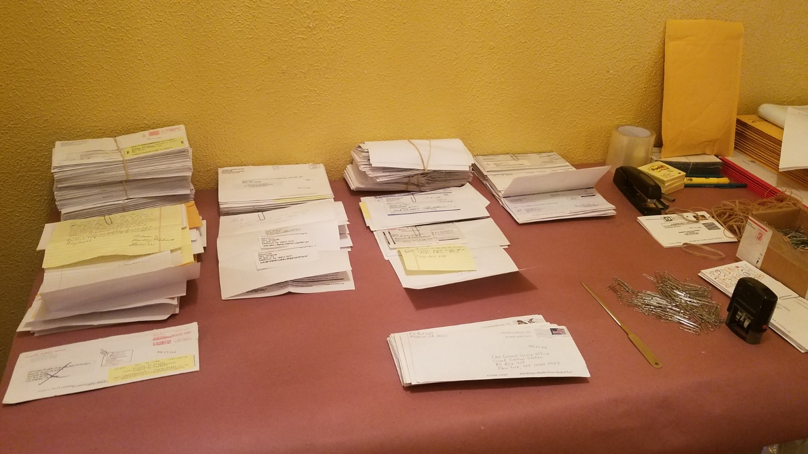
2020 Update COVID-19 Impact
carrying the message continues despite the pandemic
The work continues – remotely
Staff continue to make sure that services are available to the membership
Board meetings and committee meetings are continuing remotely
Notes:
You can’t stop us from doing A.A. , even in a pandemic!
Online meetings sprung up all over the world, the A.A. technology community stepped up to make sure that people could find these meetings and still use the A.A. Meeting Guide App
Tell the story about Pedro traveling to people’s homes to make sure they were connected and able to support carrying the message

Slide 61
2020 Update COVID-19 Impact
carrying the message continues despite the pandemic
But the work is still continuing
And the Fellowship has ensured that the office is able to continue the work
Notes:
You can’t stop us from doing A.A. , even in a pandemic!
Online meetings sprung up all over the world, the A.A. technology community stepped up to make sure that people could find these meetings and still use the A.A. Meeting Guide App
Tell the story about Pedro traveling to people’s homes to make sure they were connected and able to support carrying the message

Slide 62
7th Tradition Contributions
During Fellowship Rally
Notes:
New ways to pay. This slide illustrates how 7th Tradition contributions are coming in.

Slide 63
AAWS NET SALES THROUGH JULY 2020
GL Account # |  | January | February | March | April | May | June | July | YTD
Account | Sales
4199 | Literature Sales | $ 1,359,275 | $ 1,269,261 | $ 901,699 | $ 273,216 | $ 436,154 | $ 659,698 | $ 666,206 | $ 5,565,510
4180 | Shipping Charge | $ (23,312) | $ 25,436 | $ 16,843 | $ 164 | $ 67 | $ (10) | $ 30 | $ 19,218
4175 | Misc. Over/Shorts | $ (56) | $ (75) | $ (163) | $ - | $ (35) | $ (43) | $ (73) | $ (445)
4400 | Non-Operating Income | $ 929 | $ 7,719 | $ (8,749) | $ - | $ - | $ - | $ - | $ (100)
Gross Sales |  | $ 1,336,837 | $ 1,302,340 | $ 909,631 | $ 273,380 | $ 436,187 | $ 659,646 | $ 666,163 | $ 5,584,183
 | Less: Discounts Allowed
4176 | Overseas | $ (4,328) | $ (2,055) | $ (1,856) | $ (17) | $ (50) | $ (752) | $ (1,717) | $ (10,775)
4177 | External | $ (16,119) | $ (14,998) | $ (8,299) | $ (961) | $ (56) | $ (203) | $ (40,211) | $ (80,847)
Net Sales |  | $ 1,316,391 | $ 1,285,287 | $ 899,476 | $ 272,401 | $ 436,081 | $ 658,691 | $ 624,234 | $ 5,492,561
 | Cost of Goods Sold:
9100 | Manufacturing | $ (286,202) | $ (393,239) | $ (170,264) | $ (136,337) | $ (114,513) | $ (115,167) | $ (179,160) | $ (1,394,880)
6100/6300 (AAWS) | Shipping/Warehouse/Supplies | $ (124,937) | $ (120,274) | $ (204,733) | $ (68,709) | $ (10,789) | $ (105,375) | $ (33,651) | $ (668,467)
Gross Profit |  | $ 905,252 | $ 771,774 | $ 524,479 | $ 67,355 | $ 310,780 | $ 438,150 | $ 411,424 | $ 3,429,214
Cummulative |  |  | $ 1,677,026 | $ 2,201,505 | $ 2,268,860 | $ 2,579,640 | $ 3,017,790 | $ 3,429,214

Slide 64
Grapevine
Circulation |  | June 2020 | June 2020 | Variance | June 2019
 |  | Actual YTD | Budget YTD | Actual vs Budget | Actual YTD
GV Magazine |  | 67,635 | 67,828 | (193) | 66,765
GV Online |  | 3,865 | 4,070 | (206) | 3,006
GV Sub APP |  | 856 | 1,543 | (687) | 2,151
 | Total Circulation | 72,355 | 73,441 | (1,086) | 71,922
Financial Activity
 |  | June 2020 | June 2020 | Variance | June 2019
Revenue |  | Actual YTD | Budget YTD | Actual vs Budget | Actual YTD
Net Magazine |  | 650,046 | 604,823 | 45,223 | 692,076
Net Other Publishing |  | 215,848 | 394,927 | (179,079) | 310,653
Reserve Fund Interest |  | 15,000 | 15,000 | 0 | 15,000
 | Total Income | 880,893 | 1,014,749 | (133,856) | 1,017,730
 |  | June 2020 | June 2020 | Variance | June 2019
Expenses |  | Actual YTD | Budget YTD | Actual vs Budget | Actual YTD
Editorial |  | 330,724 | 384,395 | (53,671) | 355,548
Circulation & Business |  | 495,606 | 440,885 | 54,721 | 598,135
General & Administrative |  | 147,475 | 164,404 | (16,929) | 134,340
 | Total Cost & Expenses | 973,805 | 989,684 | (15,879) | 1,088,024
 | Net Income | (92,911) | 25,065 | (117,977) | (70,294)

Slide 65
LaVina
Circulation |  | June 2020 | June 2020 | Variance | June 2019
 |  | Actual YTD | Budget YTD | Actual vs Budget | Actual YTD
LV Magazine |  | 8,628 | 10,100 | (1,472) | 10,360
 | Total Circulation | 8,628 | 10,100 | (1,472) | 10,360
Financial Activity
 |  | June 2020 | June 2020 | Variance | June 2019
Revenue |  | Actual YTD | Budget YTD | Actual vs Budget | Actual YTD
Net Magazine |  | 12,854 | 26,617 | (13,763) | 14,655
Net Other Publishing |  | 4,827 | 7,087 | (2,260) | 9,002
 | Total Revenue | 17,680 | 33,703 | (16,023) | 23,658
 |  | June 2020 | June 2020 | Variance | June 2019
Expenses |  | Actual YTD | Budget YTD | Actual vs Budget | Actual YTD
Editorial |  | 97,861 | 112,907 | (15,046) | 85,648
Circulation & Business |  | 65,400 | 76,468 | (11,068) | 44,709
General & Administrative |  | 2,480 | 2,841 | (361) | 4,582
 | Total Cost & Expenses | 165,741 | 192,216 | (26,475) | 134,940
 | Net Income | (148,060) | (158,512) | 10,452 | (111,282)

Slide 66
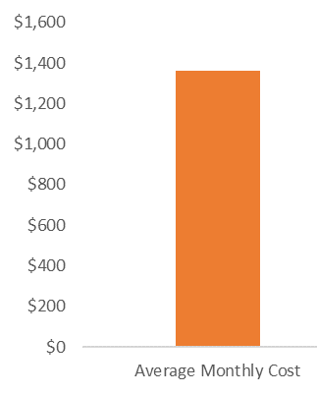
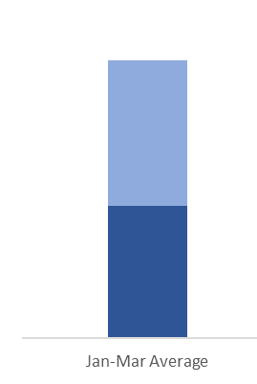
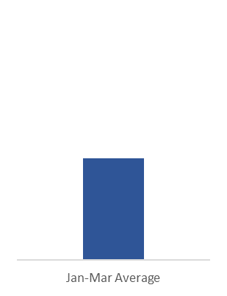


2020 Update COVID-19 Impact
Current financial situation Costs and income
Gap of ~$700K expected for the next 3 to 4 months without a significant call out to the fellowship for contributions
$1.4 MM
$1.4 MM
AVG. Q1
Lit Sales
$730 K
Gap of ~$700K
This gap is further increased by remaining Convention costs and Capitol expenses (ERP, eighth floor renovation)
$680 K
$145 K
April
Lit Sales
AVG. Q1
Contributions
$670 K
April
Contributions
$540 K
Notes:
Our costs are generally covered by our income from contributions and literature – We have been discussing how we might be too dependent on our literature sales for years now and that is playing out right now.
When physical meetings stopped happening the literature sales dropped significantly
The result is a gap between our income and our costs of roughly $700,000 each month

Slide 67
August 2020 Update COVID-19 Financial Impact
Working together- INCREASED Membership contributions and cutting costs are reducing the gap caused by a sharp decrease in literature sales
Your General Service Office
Budget Updates Due to COVID-19
Monthly Income vs. Monthly Budgeted Costs
Orig 2020 budget monthly average cost to run the General Service Office
Literature
Sales
Updated Budget 2020
Contributions
New budget cuts costs by $3MM
Membership stepping up in the contributions nearly doubling the
average of $670k per month before the pandemic - Please keep it up!
Notes:
Our primary financial goal is to get through 2020 in the black
Our secondary financial goal is to pay back the reserve fund by end of 2022

Slide 68




2020 Update COVID-19 Impact
The plan ahead – helping the membership to be self supporting
Getting you the facts here and now | Adding more channels for receiving contributions PayPal Venmo | Releasing a video to be played in online meetings with this information | Regular updates from your general service office keeping you informed of the progress
Are you getting enough information? Do we need to send more updates? Different Updates? Let us know!
Could not add Venmo – but we tried!

Slide 69
2020 Update COVID-19 Impact
Key talking points for the fellowship
1 | 2 | 3
A.A. is still here! We actually thrive in uncertainty– hope remains, and the message continues to be carried | Our prudent reserve is designed precisely for this situation and will carry us through until the membership can get us back on our feet | This is unprecedented time in the world and a pivotal moment for A.A. Now is the time for this generation of our membership to demonstrate what self-supporting really means

Slide 70
THANK YOU
All of employees of both A.A.W.S. and Grapevine
Members of Trustees’ Finance and Budgetary Committee, along members of the Finance Committees of A.A.W.S. and Grapevine
Our Independent Auditors – Marks Paneth, LLP
************
Any questions – Please feel free to contact me at – lesbackus50@gmail.com

