Slide 1


Slide 2
70th General Service Conference
“2020 A Clear Vision for You”
Delegate Report-back June 6, 2020
Presented by:
Cynthia terl
Area 29 Panel 70 Delegate

Slide 3
Why ARE we here?
Why do we have a conference?
And….. what does any of this have to do with me as an individual AA member anyway?

Slide 4

Why
we needed a conference.
Notes:
But after Dr. Bob contracted cancer and lay dying, it became an urgent necessity to create a General Service Conference to represent and serve the A.A. groups.

Slide 5
From
the
Groups
Flow
Ideas
Money
People
And
Dele-
gated
Authority
Services
Flow
Back
Up
To
the
Groups
Where
12th
Step
Work
Is
Done

Slide 6
Who Makes Up the Conference
135 CONFERENCE MEMBERS
GSO/GRAPEVINE STAFF 15 = 11.2%
So, the
groups are
in charge.
2/3 vote to
delegates
TRUSTEES/DIRECTORS 27 = 20%
DELEGATES 93 = 68.8%
Meets once a year
For one week

Slide 7
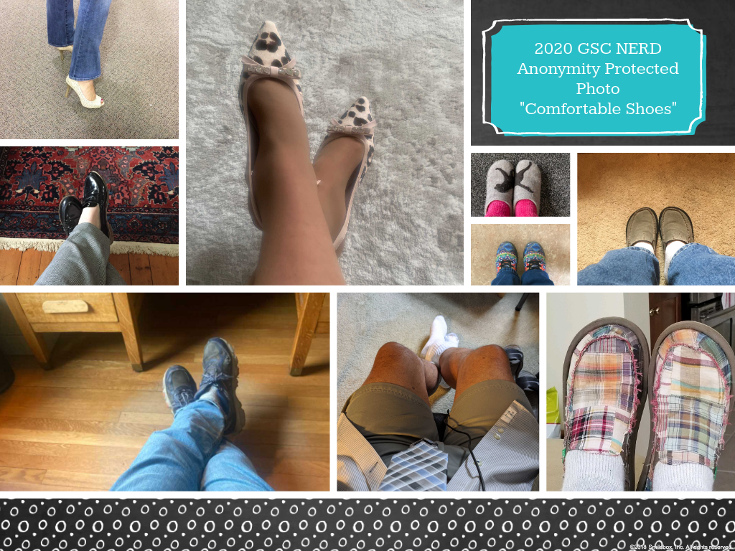

Slide 8

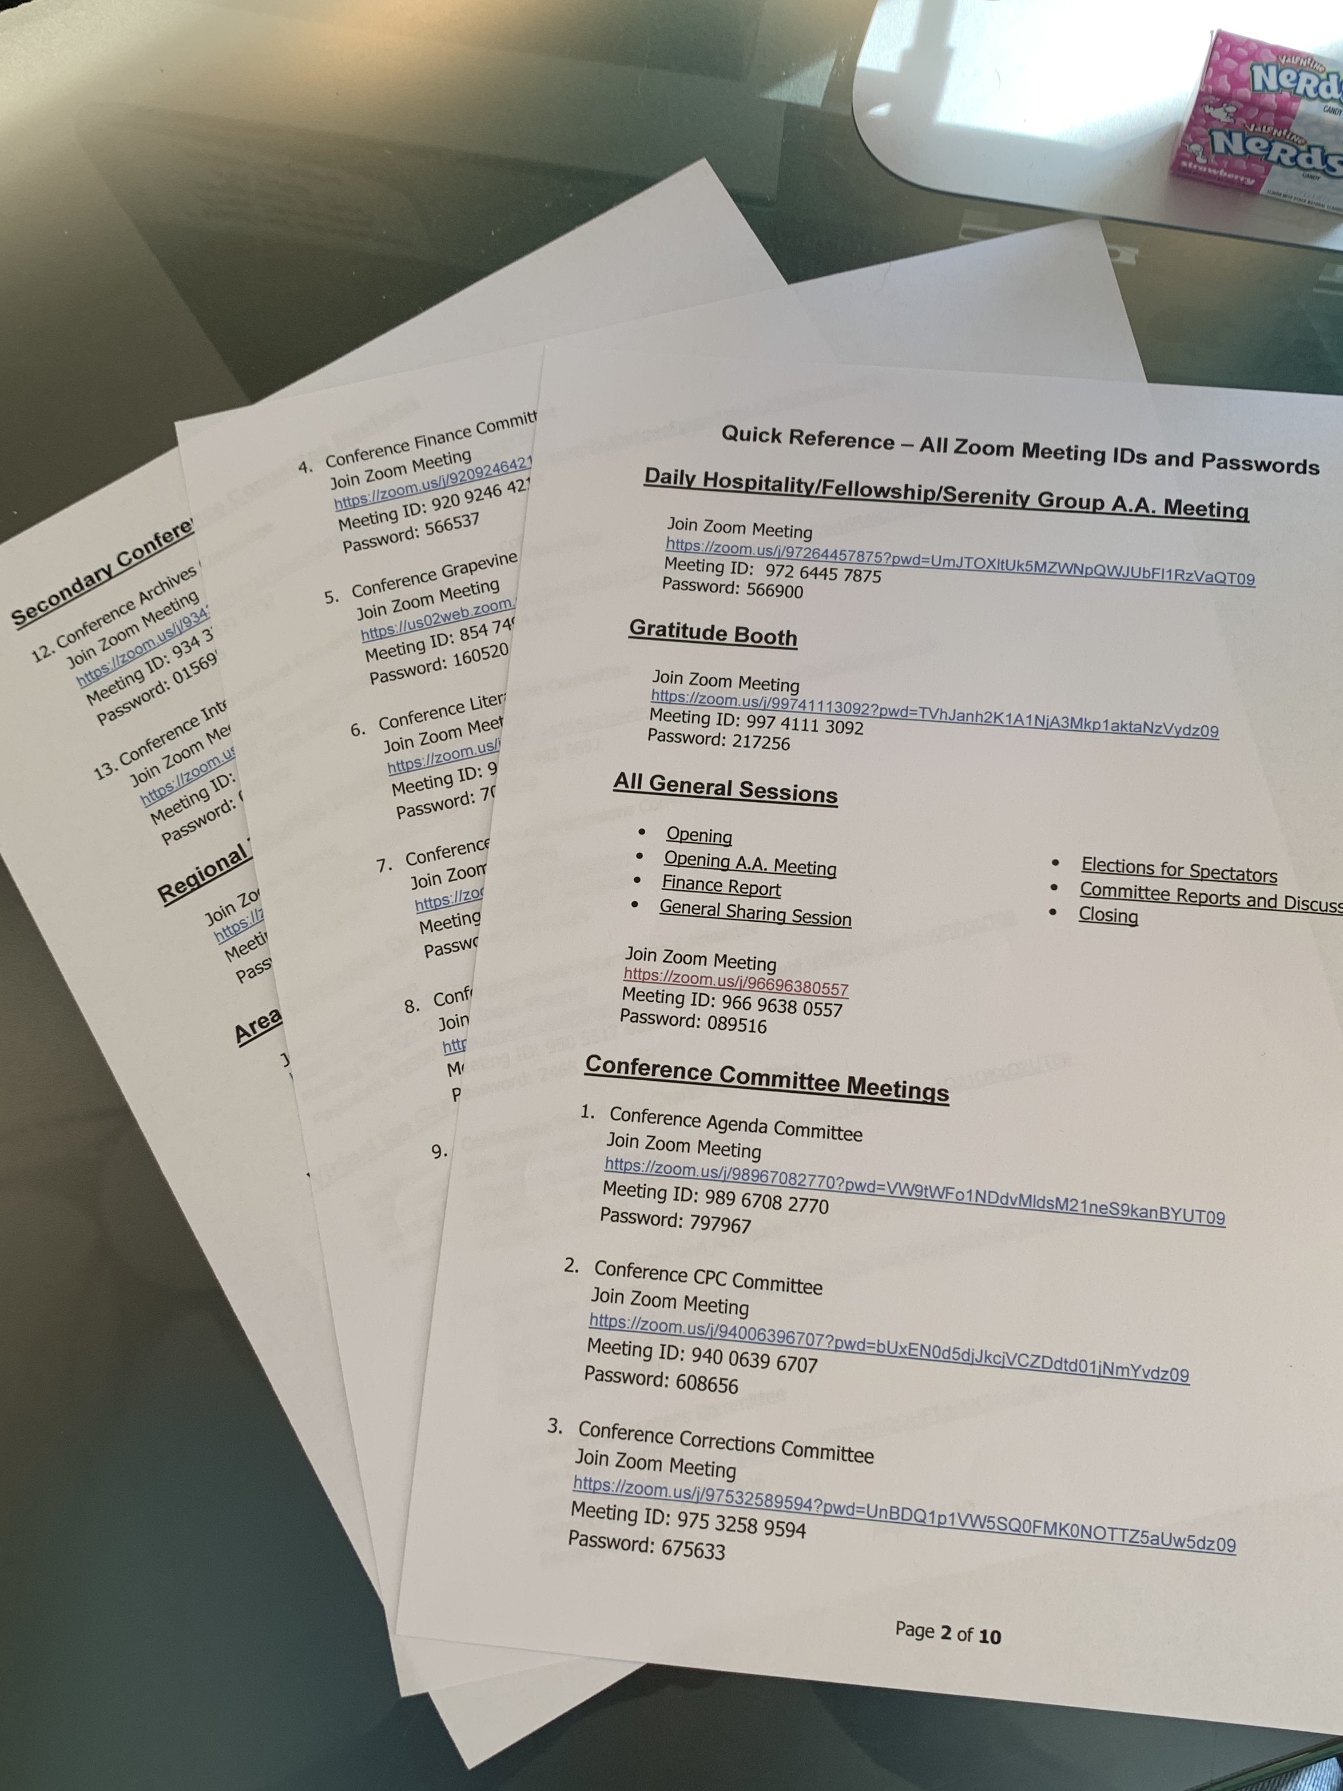
THREE PAGES OF ZOOM MEETING ID AND PASSWORDS

Slide 9
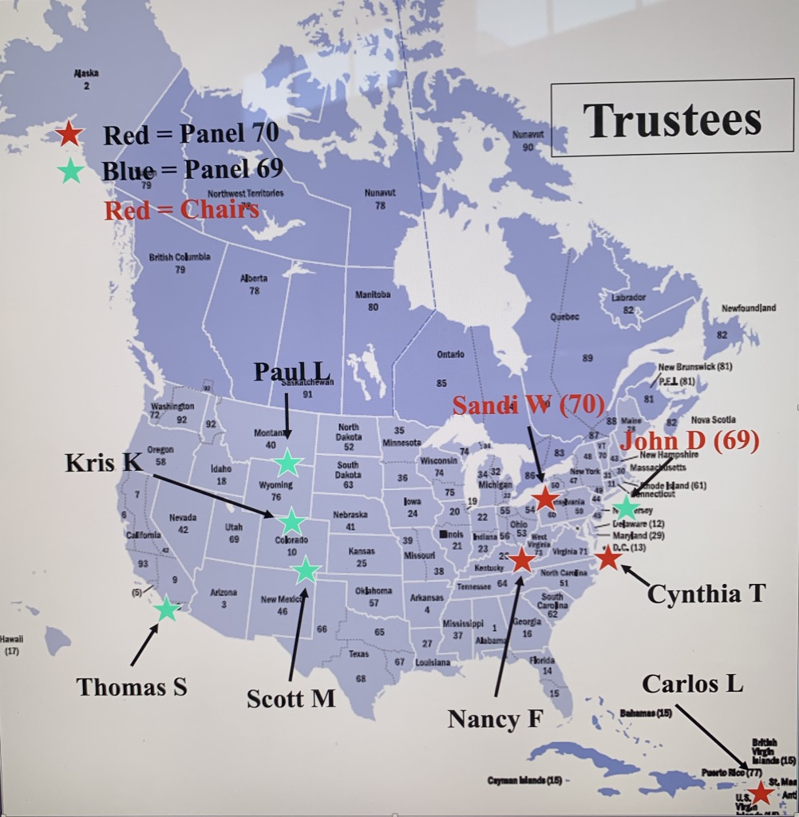
Trustees Delegate Conference Committee
Panel 69 Panel 70
John D. (11) Sandi W. (86)
Kris K. (75) Nancy F. (56)
*Paul L. (40) Carlos L. (77)
Scott M. (10) *Cynthia T. (29)
Thomas S. (05)
* Alternate Chairs

Slide 10
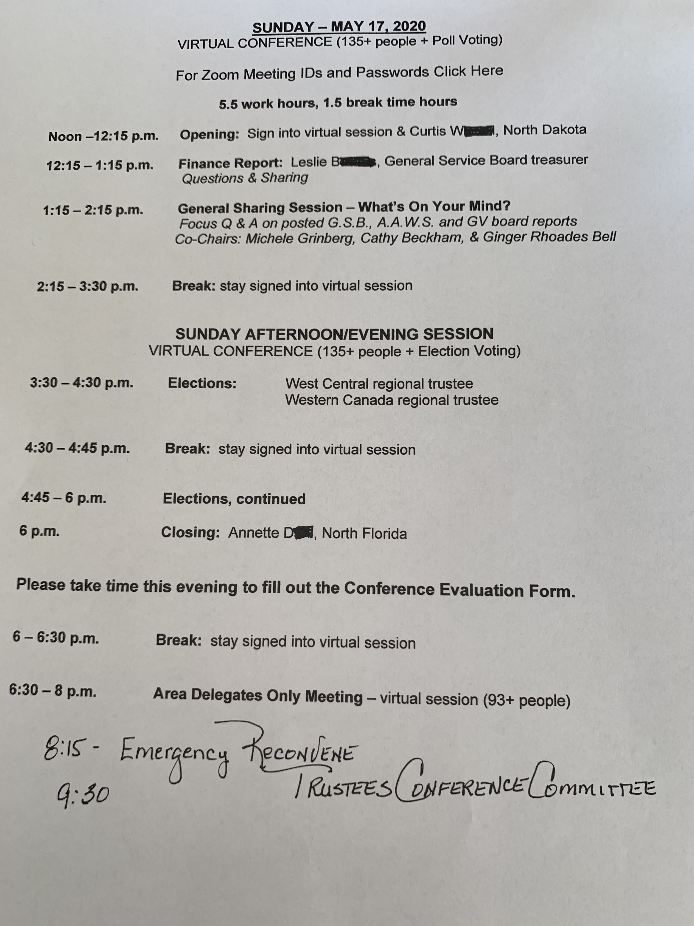
Sunday was the second day of navigating the “virtual” waters of efficient and effective conference work.
The Third Legacy election process was as spiritual as any I have ever witnessed.

Slide 11

And up next:
THE FINANCIALS

Slide 12
2019 FINANCIAL HIGHLIGHTS
7th Tradition of Self-Support – $8.86 million set another record, up 5.71% from 2018
AAWS publishing profits – $9.36 million down 1% from 2018, used to cover shortfall between 7th Tradition and Cost of Services, resulting in net GSO loss of $379,665
Grapevine subscription levels decreased 2% in 2019. 2019 results were a loss of
$44,461 thousand
General Fund support of La Viña service activity – $289,314 thousand
Reserve Fund – $16.2 million resulting in ratio of 9.2 months

Slide 13
2019 FINANCIAL HIGHLIGHTS
Due to many issues with the transition to the new ERP system the audit on the
financial results for 2019 has not been completed. The audit should be completed and reviewed by the Audit Committee by May 30th
There may also be several versions of 2019 Income Statements for AAWS and the Grapevine. A final audited version of the financials will be included in the Final Conference Report.
So if you see a few numbers that don’t quite match don’t worry the Finance
Department and Marks Paneth, our independent auditors, are working to make sure the final audited financial for 2019 are correct.

Slide 14
2019 Financial Results – What Happened?
The 2019 GSO Budget showed a net profit of $501,221 but the actual for 2019 is a loss of $379,655
Income was $62,512 less than budgeted and expenses were $943,388 more than budgeted
Expenses for Contracted Services and Professional Fees were higher than expected
Professional Fees were $317,653 over budget, in large part due to contract reviews.
AAWS is in the process of implementing a new way to review contracts which is both cost efficient and less time consuming
Contracted Services were $831,948 over budget, in large part due to the implementation of NetSuite, the new ERP System

Slide 15
2019 HIGHLIGHTS
28,180 Groups made $6.9 million of 7th Tradition contributions
Represents 40.6% of total groups
$245.71 average group contribution
Individuals, Memoriam & Special Meetings contributed $1.3 million of 7th Tradition contributions
Total 7th Tradition contributions were $8.86 million

Slide 16
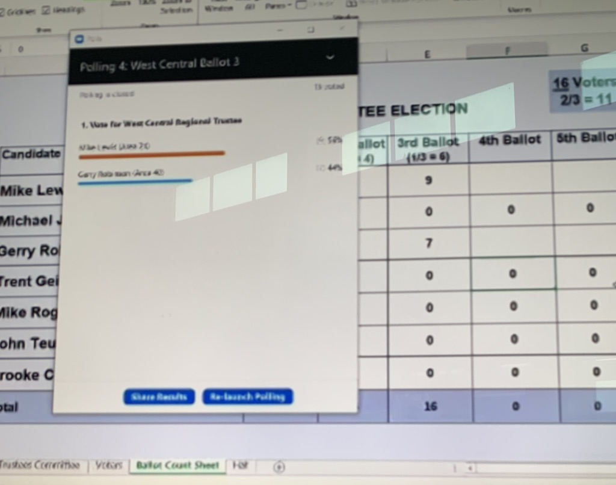
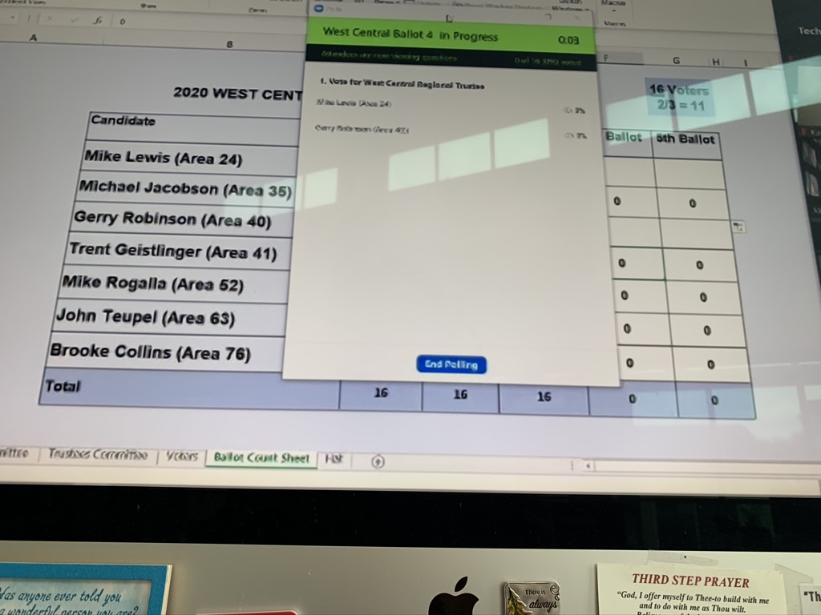
Voting Procedure For Regional Trustees

Slide 17
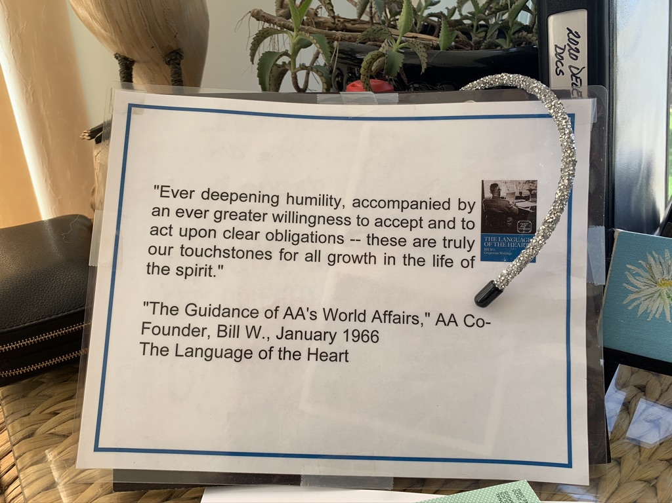

Slide 18
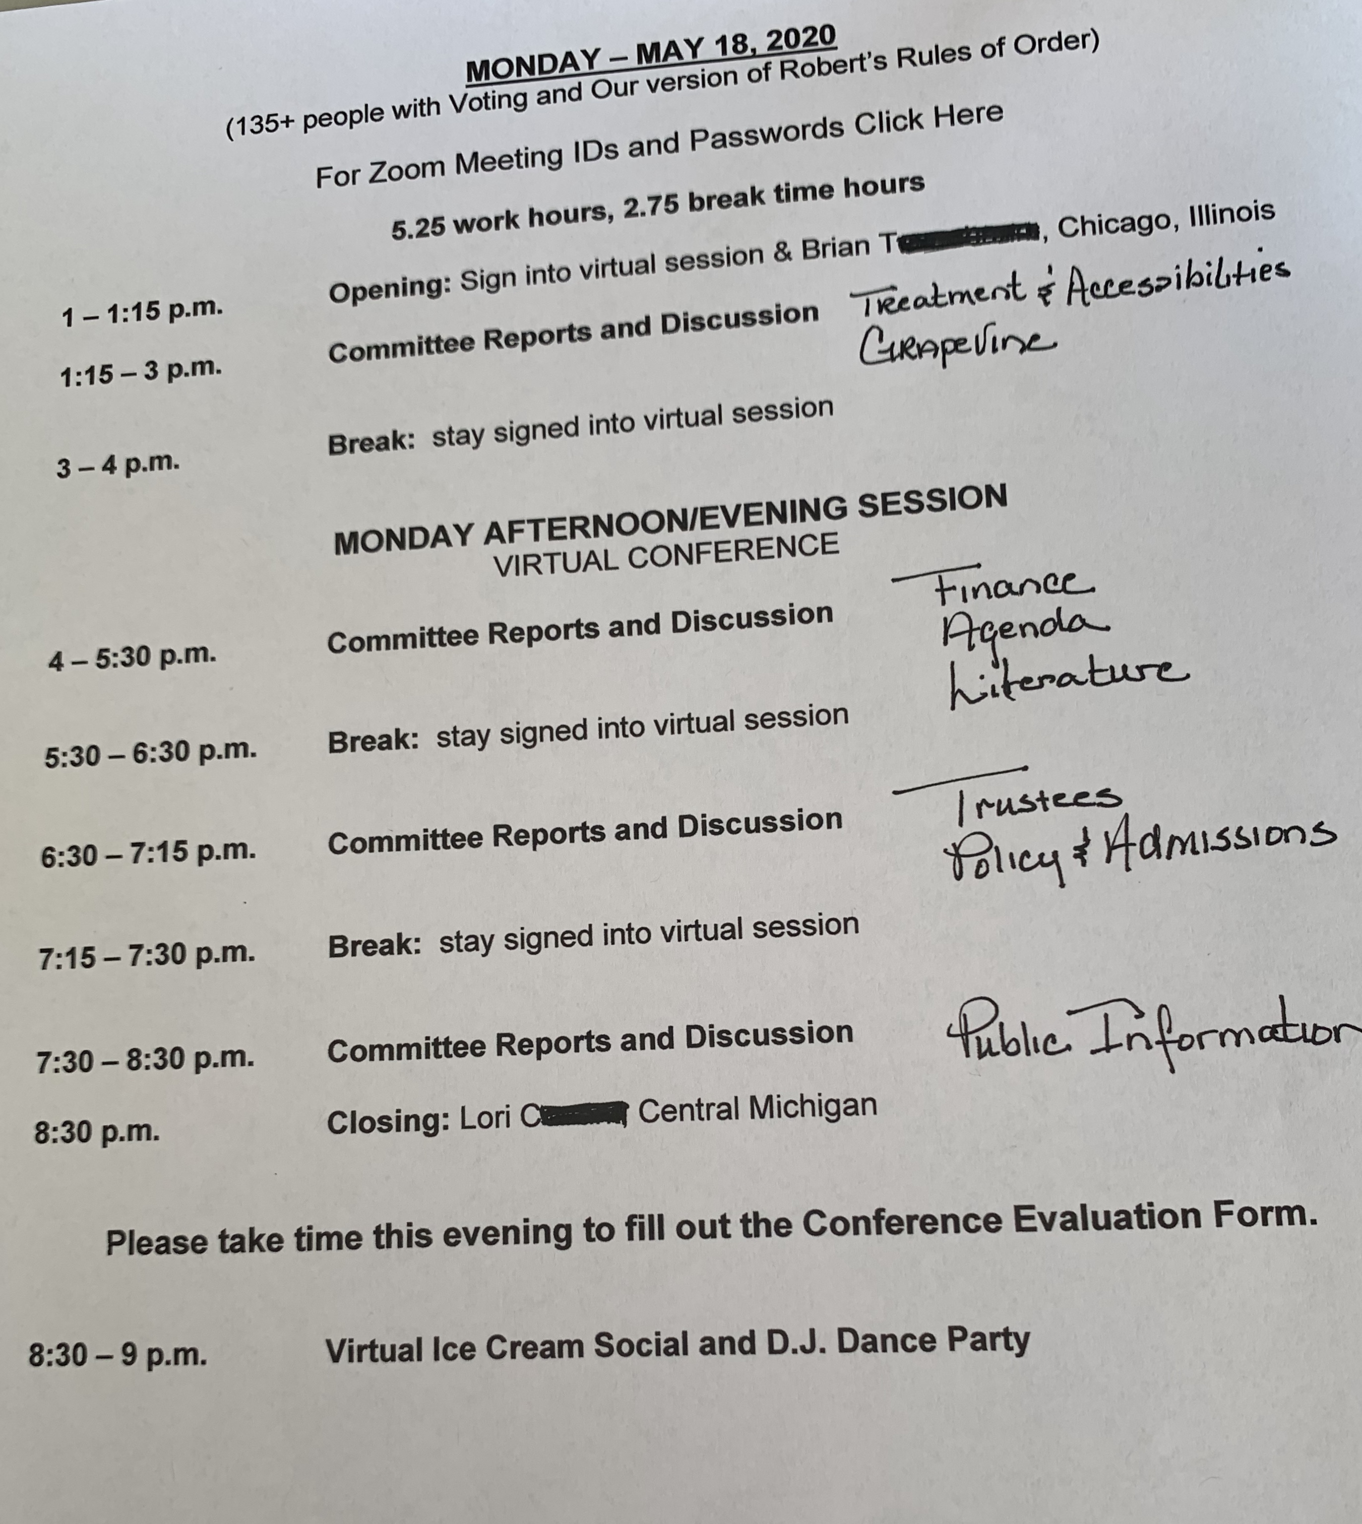

Slide 19
CARC I
V. Grapevine | H. | Consider a request for AA Grapevine, Inc. to establish an Instagram account in line with the Twelve Traditions. | CC: The committee encourages AAGV, Inc. to continue with their planning. The committee suggested that the GV Board provide additional information on implementation, anonymity, security, affiliation, outside contributions, privacy and promotion and bring a progress report back to the 71st GSC.
XI. Trustees | E. | Consider the revised “Procedures for a Partial or Complete Reorganization of the General Service Board, the A.A.W.S. or AA Grapevine Boards.” | Item forwarded to the 71st G.S.C due to lack of time. The committee noted for the 71st General Service Conference the following information regarding their discussion to include a memo for the 71st General Service Conference proposing consideration of alternate trustees.
V. Grapevine | D. | Consider revising the A.A. Preamble to use gender neutral pronouns. For example, "Alcoholics Anonymous is a fellowship of people who share their experience, strength and hope with each other..." | CC: The committee also discussed making suggested changes to the A.A. Preamble for gender neutral pronouns. The committee requested that the Grapevine Board consider developing examples of generalized language options and that a progress report or draft versions be brought back to the 71st General Service Conference.
VIII. Public Information (Cont) | K. | Review “A.A. Triennial Membership Survey” report. | CC: The committee reviewed and accepted the trustees’ Public Information Committee report on the A.A. Membership Survey. The committee noted it was encouraged by some of the findings by the survey professional and asked that the trustees’ Public Information Committee continue to explore this topic. The committee also suggested the exploration of a possible digital questionnaire feedback form be part of their discussions.
XIII. International Conventions/Regional Forums | A. | Discuss methods of closing the Big Meetings at the International Convention. | CC:The committee agreed that further discussion on the use of the Lord’s Prayer as a closing at the Big Meetings of the International Convention would be beneficial and suggested that the 2021 Conference Committee on International Conventions/Regional Forums continue discussion at the 71st General Service Conference.
VI. Literature (Cont) | M 2 | Develop a Fifth Edition of the book Alcoholics Anonymous with updated stories and revisions to Appendices III and V. | Item forwarded to the 71st G.S.C. prior to conference via agenda modification
VI. Literature (Cont) | T 1 | Consider revising the pamphlet “Questions & Answers on Sponsorship”: Change the suggestion that sponsor and newcomer be of the same sex. | Item forwarded to the 71st G.S.C due to lack of time.
VI. Literature (Cont) | J 1 | Review “A.A.W.S. Policy on Publication of Literature: Updating Pamphlets and Other A.A. Materials” approved in January 2020. | CC: The committee discussed the “A.A.W.S. Policy on Publication of Literature: Updating Pamphlets and Other A.A. Materials,” approved by A.A.W.S. in January 2020 and noted that concerns expressed by the 69th General Service Conference were addressed in full by the revised policy.
VI. Literature (Cont) | U. | Consider request to include a G.S.R. preamble in the pamphlet “G.S.R.: Your Group’s Link to A.A. as a Whole.” | Item forwarded to the 71st G.S.C due to lack of time.
X. Treatment and Accessibilities | A. | Discuss the report on the review of materials related to Bridging the Gap activities | AA:The pamphlet “Bridging the Gap” be updated for currency and inclusion to reach a broader scope of treatment settings about temporary contact services, and that a progress report or draft be brought to the 2021 Conference Committee on Treatment and Accessibilities.

Slide 21
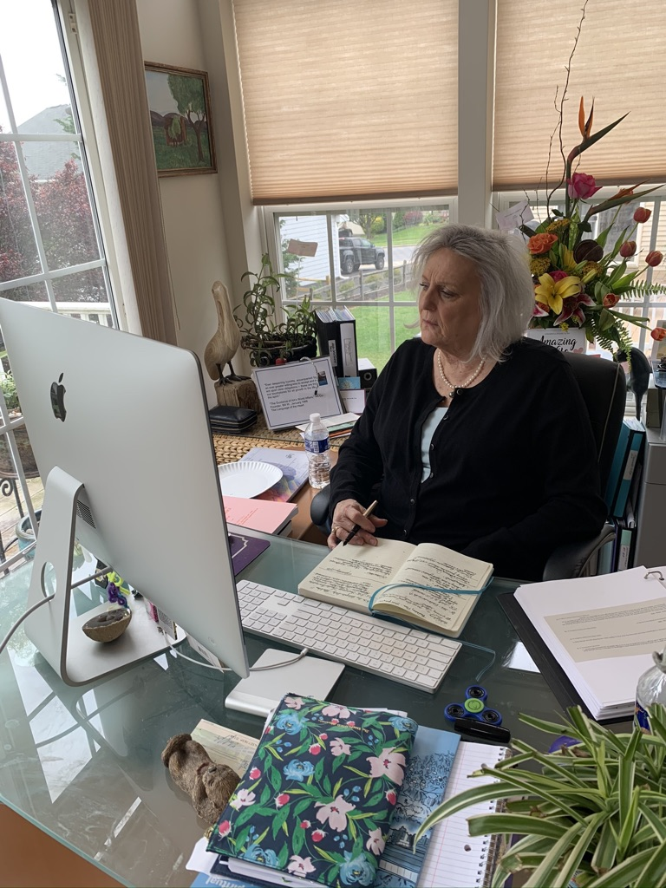
The conference members heard reports from 8 of the 11 Conference Committees on Monday.
Unfortunately due to the lack of time there was limited robust discussion on most items.
The Zoom mechanics surrounding queuing up at the mic for discussion using the raise hand feature in the participants window were challenging.
A separate mechanism for point of info, order and clarification was monitored by a Zoom Point Operator through the “chat” feature. This process at one point was dominating the discussion time and two committees that had considerations on the floor ran out of time prior to a vote as a result.

Slide 23
CARC IV
IV. Finance | A 2 | Review the pamphlet “Self-Support: Where Money and Spirituality Mix.” Consider a request regarding contribution percentages to service entities. | Item forwarded to the 71st G.S.C due to lack of time.
VI. Literature (Cont) | K. | Consider if proposed agenda items for plain language, simplified language, accessible translations and large print versions of the book Alcoholics Anonymous, as well as workbooks to help study the program of Alcoholics Anonymous, can be addressed with a common solution. | CC: The committee considered if proposed agenda items for plain language, simplified language, accessible translations and large print versions of the book Alcoholics Anonymous, as well as workbooks to help study the program of Alcoholics Anonymous, can be addressed with a common solution. The committee requested that the trustees continue to explore this topic. The committee requested that the trustees’ make available to the Fellowship, as soon as possible, in Spanish, English and French, the presentation “The Big Book: Researching Issues, Possible Tools and Access (70th General Service Conference 2020)” that was presented to the committee during their May 2, 2020 agenda reduction meeting. The committee noted the importance for the Fellowship to be informed about the nature of the accessibility challenges with regard to A.A. literature. The committee requested that a progress report be brought back to the 2021 Conference Committee on Literature.
IX. Report and Charter | C. | Consider restoring the two paragraphs and the accompanying footnote in the Concept Eleven essay of The Twelve Concepts for World Service that were removed by an advisory action of the 66th General Service Conference. | CC:The committee discussed restoring the two paragraphs with the accompanying footnote in the Concept Eleven essay of The Twelve Concepts for World Service that were removed by an Advisory Action of the 66th General Service Conference and took no action. The committee agreed that the footnote noting that the two paragraphs are available upon request from the G.S.O. Archives department is adequate.
VI. Literature (Cont) | M 1 | Develop a Fifth Edition. | Item forwarded to the 71st G.S.C due to lack of time.
VI. Literature (Cont) | S. | Consider request to revise text related to self-support in the pamphlet | Item forwarded to the 71st G.S.C. prior to conference via agenda modification
V. Grapevine | E. | Consider a request to change the language of the first sentence of the A.A. Preamble as follows: "Alcoholics Anonymous is a fellowship of people who share..." | CC: The committee considered a request to change the language of the first sentence of the A.A. Preamble as follows: "Alcoholics Anonymous is a fellowship of people who share..." and took no action.
VI. Literature (Cont) | T 2 | Consider revising the pamphlet “Questions & Answers on Sponsorship”: Expand the section on “Service Sponsorship” and retitle the pamphlet to “Frequently Asked Questions About A.A.” include service sponsorship. | Item forwarded to the 71st G.S.C. prior to conference via agenda modification
VIII. Public Information (Cont) | J. | Consider a request to develop a plan to create an A.A. podcast. | CC: The committee discussed a request to develop a plan to create an A.A. podcast. The committee suggested that G.S.O. explore the development of a draft plan to create a G.S.O. podcast to be brought back to the 2021 Conference Committee on Public Information.
VI. Literature | H. | Review draft language regarding safety and A.A. to be included in Living Sober and “Questions and Answers on Sponsorship.” | CC: The committee reviewed the progress report regarding safety and A.A. to be included in Living Sober and “Questions and Answers on Sponsorship.” The committee requested a review of the draft language be taken with accessibility in mind as it relates to reading level. The committee requested that a progress report or draft pamphlet be brought back to the 2021 Conference Committee on Literature.
I. Agenda | C. | Review workshop topic ideas for the 2021 General Service Conference. | AA: The workshop topic for the 2021 General Service Conference be : Inform - Communicate/Involve - Act/Inspire - Attract (The theme for the 2021 GS C "A.A. in a Time of Change")

Slide 24
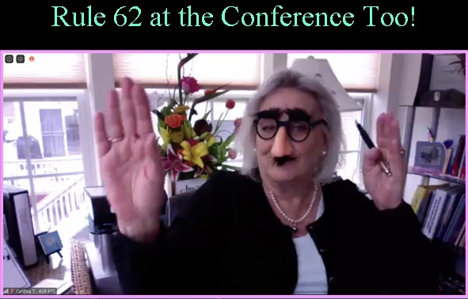

Slide 25
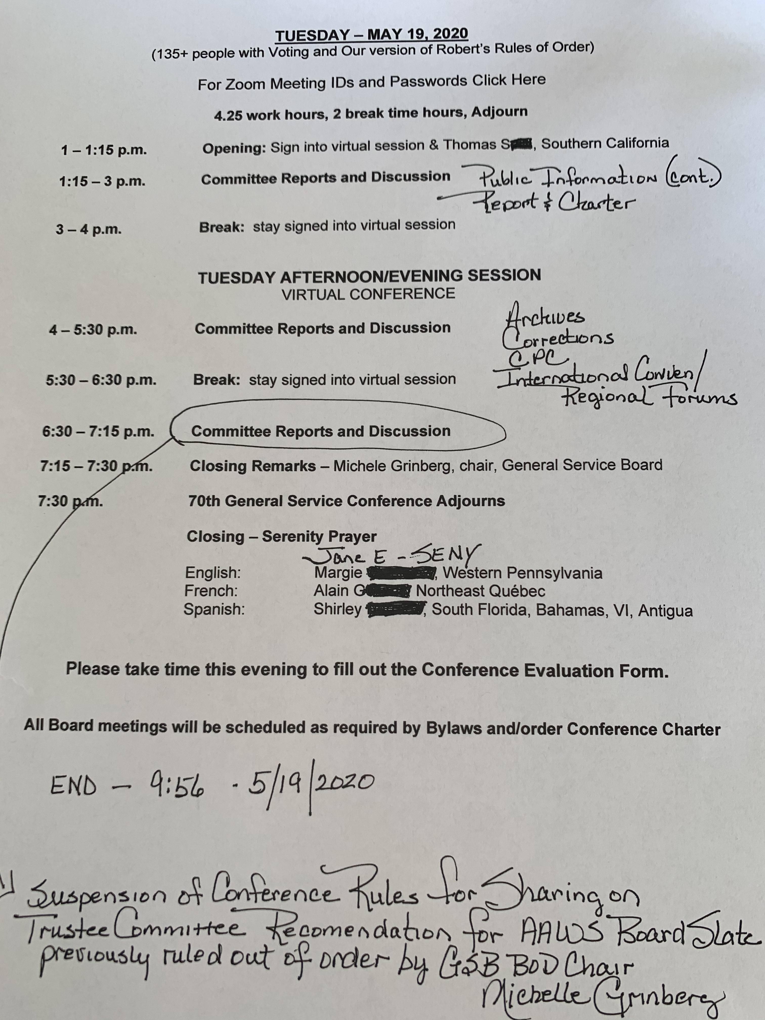
The final day began as usual in the “Hospitality Room”. Each day we became more comfortable with one another as members of the 70th GSC but more importantly as AA members dedicated to service to the fellowship that we all love and that saved our lives.
Today Class B Trustee Mark E. tied his camouflage bowtie in honor of Past Trustee Don M. for us all. Then the cowboy hats began to appear and there was a joy that engulfed the entire virtual room, it was the joy of fellowship.

Slide 26
CONFERENCE FLOOR ACTIONS OF THE 70th GENERAL SERVICe CONFERENCE
The following items were moved forward to the trustees’ Committee on the General Service Conference
The Finance Committee expand item #2 that will be forwarded to the 71st Conference to include the proposal to revise the pie chart percentages, in order to emphasize more clearly that any percentages included in the pamphlet are only suggestions and examples, not recommendations.
The General Service Conference consider developing a PSA about Alcoholics Anonymous geared toward minorities.
The 70th General Service Conference approve the slate of Directors for A.A. World Services, Inc. as originally submitted: Beau Bush, Mary Cumings, Jimmy Dean, Deborah Koltai, Jan Lembke, David Noll, Greg Tobin, Carolyn Walsh, John Weis
The pamphlet “A.A. for the Black and African-American Alcoholic” be updated to include fresh stories and a new title that is respectful and inclusive.
The slate of Directors of A.A. World Services, Inc., as submitted by the Conference Committee on Trustees, be approved.
The launch of Google AdWords Grants by the General Service Office be halted until the 71st General Service Conference convenes and approves that launch, and that the “Ad Hoc Committee Progress Report - Google Grants and the 7th Tradition,” from the trustees’ Finance Committee, dated March 30, 2020, be immediately released to all members of the 70th General Service Conference.
One Floor Action Declined for Consideration: Consider the extension of the 71st General Service Conference by as many as three working days

Slide 27
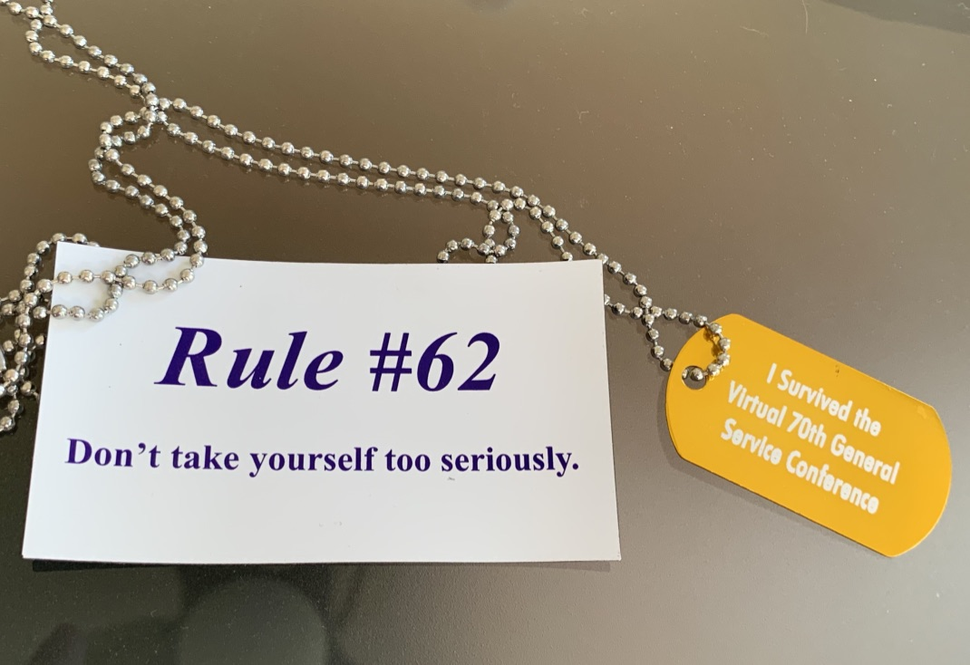
Gifts From our NERT

Slide 28
Thank you for the incredible gift you offered me by placing your trust in me to carry YOUR voice
the TRUE voice of AA
to this historic gathering of AA members passionately (and virtually) doing the work of AA.
I am sure without a shadow of a doubt that the late Bernard Smith, non-alcoholic
chair of the Board of Trustees, would approve of the 70th GSC’s answer to
“Why do we need a conference?”
as it resonated his own thoughts as he addressed another historical AA service meeting in 1954.
I would like to close with his words…..

